Slide 1
Barnfield Parent Meeting 2020
Year 1

Slide 2
Arrival
Early Years, KS1 and siblings in KS2 – Gaskarth Road entrance
KS2 only – Silkstream entrance
A-M arrive between 8:45 and 8:55
N-Z arrive between 8:55-9:05
It is important you stick to these timings so that the entrances do not get too busy.
The first 10 minutes of the day is essential learning time. The children will practise spelling strategies, times tables, arithmetic and other key skills as soon as they arrive.
We find that children who arrive on time have a calm, settled start to their day and are more ready to learn.

Slide 3
Dismissal
Early Years and KS1 -Gaskarth Road entrance
KS2 and younger siblings – Silkstream entrance
A-M collect between 2:55 and 3:05
N-Z collect between 3:05-3:15
It is important you stick to these timings so that the entrances do not get too busy.
It is important that parents with children in both KS2 and early years/KS1 collect from the Silkstream entrance FIRST and follow the one way system which will lead them round to the early years and KS1 classrooms.

Slide 4
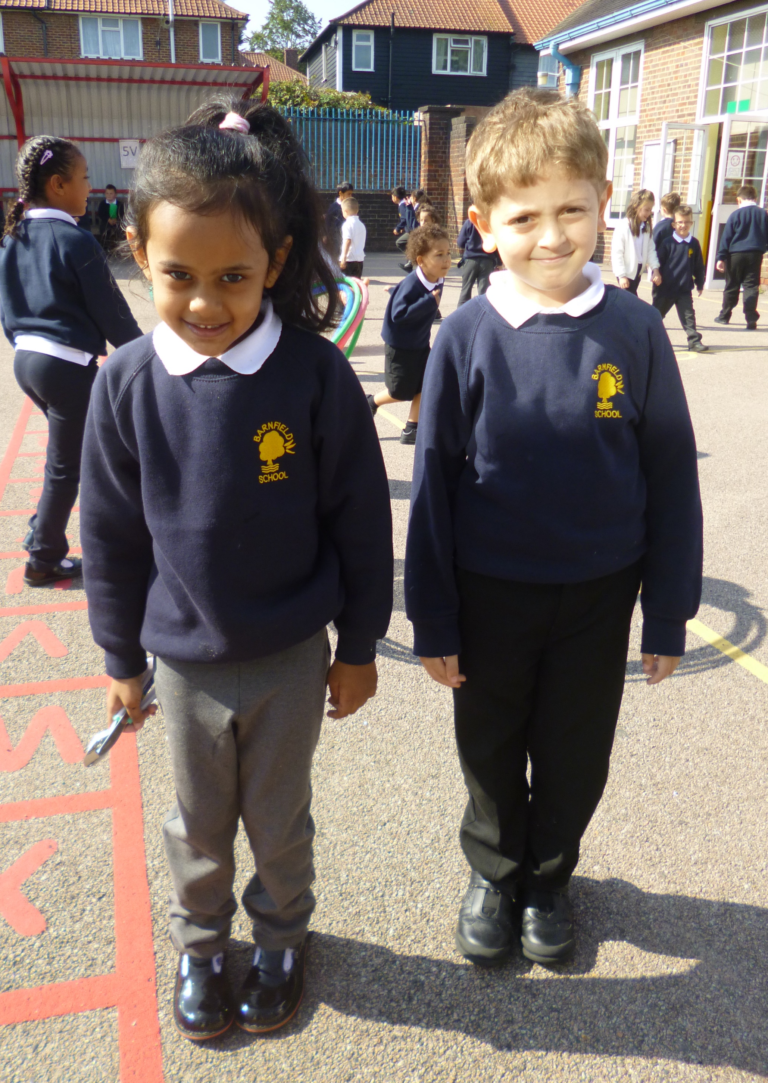
Uniform
· Smart black shoes - no trainers (unless a PE day)
· Hair styles - must be sensible (no lines
shaved in the sides for boys. No 'extreme hairstyles.')
· Label EVERYTHING!
· Girls can wear boots with trousers ONLY.
(If they wear a skirt, they need to wear
SHOES.)

Slide 5
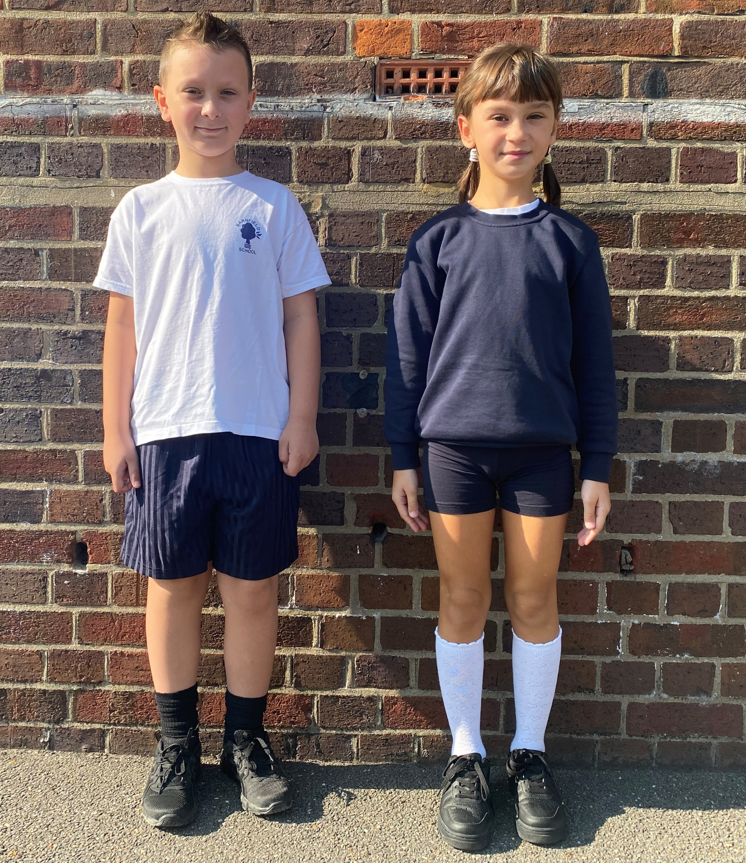
PE Kit
Plain blue or black tracksuit
Plain white t-shirt or Barnfield logo PE top
Blue shorts
Trainers – white or black
This year, Children must come to school in their PE kits on the day they have PE.
Your child’s PE days are:
1L – Mondays and Tuesdays
1H – Tuesdays and Wednesdays

Slide 6
Equipment
Children need to bring their own pencil case with:
Pencil
Handwriting pen
Ruler
Rubber
Sharpener
Colouring pencils
Glue
Children cannot share equipment.
Also, to help create a tidy environment, please ensure the pencil cases are not too large.

Slide 7
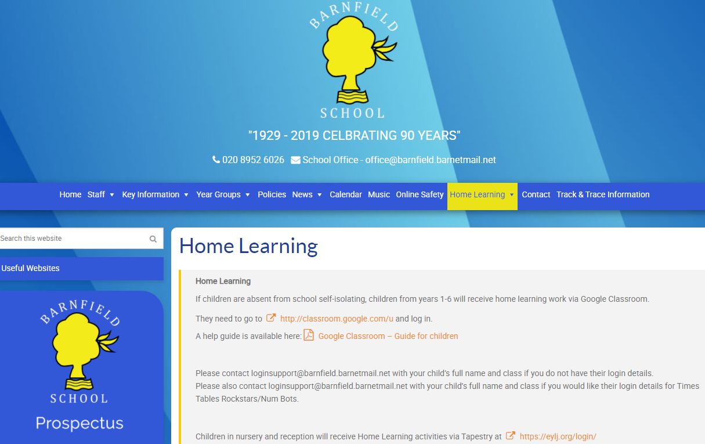
Google Classroom
All homework in years 1-6 will be set on Google Classroom.
Work will be set on Google Classroom for any children who are self-isolating.
Further information and a help guide is available at https://barnfieldschool.co.uk/home-learning/

Slide 8
Online Safety
The internet is amazing. Children can play, learn, create and connect - opening up a whole world of exciting possibilities. But with the digital world changing all the time, how can you make sure your child is staying safe?
- Set up parental controls on your wi-fi connection, phone, tablet and on any gaming devices that they use.
- Talk to your child about staying safe online:
- Agree rules with your child about not meeting up with people they have met online.
- Let them know which websites they are allowed/not allowed to visit.
- Allow them online only for a sensible duration - don't let them play for hours!
- Discuss how they treat others online.
- Make sure they are on child versions of sites like YouTube.
- If your child plays video games, ensure they are appropriate for their age.
Some useful websites are:
https://www.thinkuknow.co.uk/
https://www.nspcc.org.uk/keeping-children-safe/online-safety/

Slide 9
Homework
Home work is set on a Friday.
Literacy and numeracy alternate weeks.

Slide 10
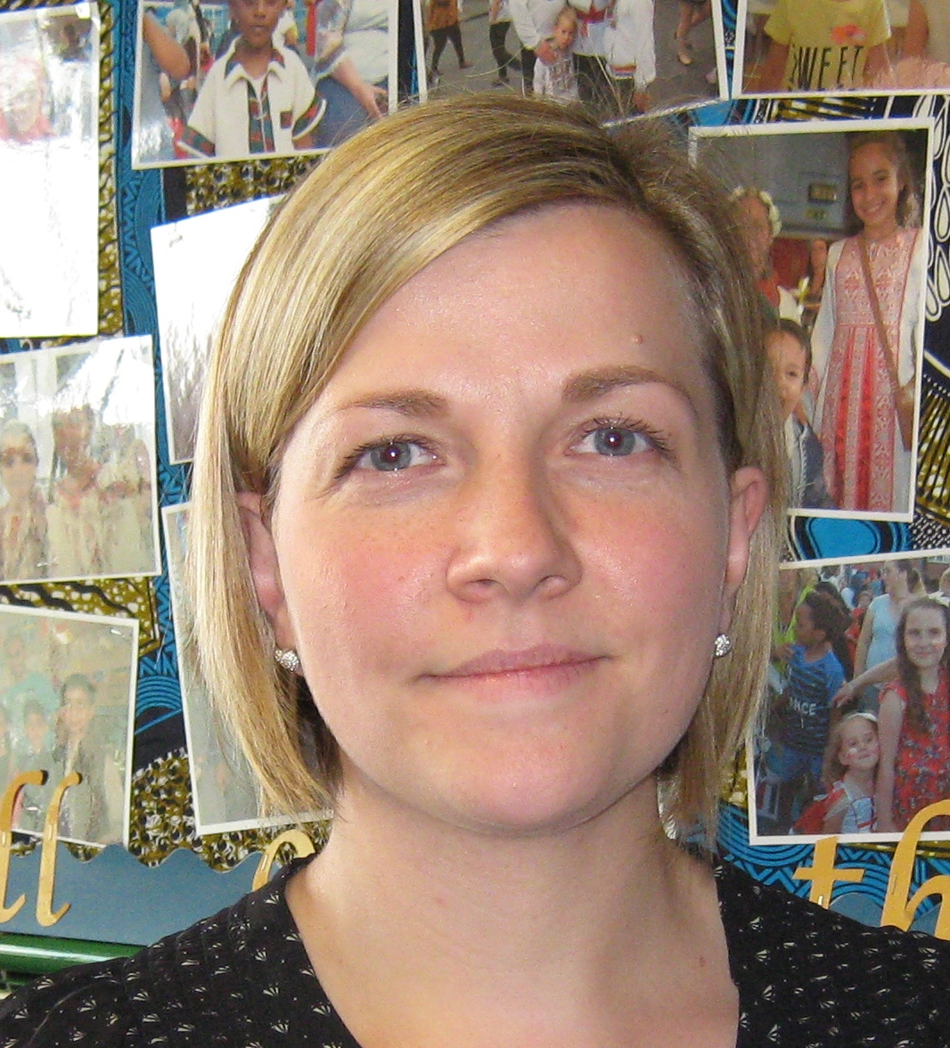
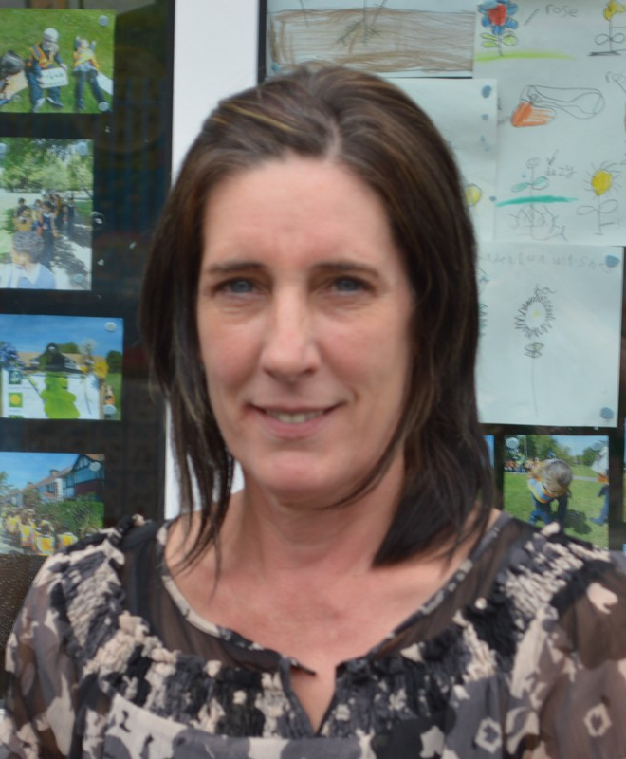
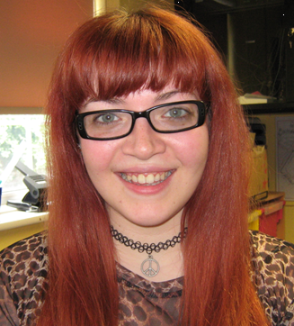
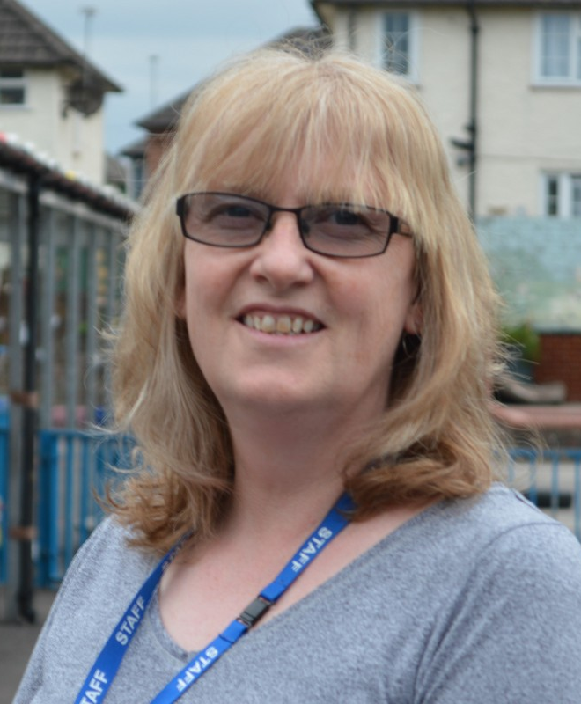
Who are the adults in your child’s year group?
Mrs Leane Miss Cassidy Miss Hanham Mrs Barker

Slide 11
What will your child be learning this year?
Autumn Term
Maps and learning about our local area. Counting forwards and backwards and solving problems developing their use of mathematical vocabulary.
Learning how to write in full sentences with correct letter formation around Traction Man and Claude in the City.
Spring Term
Learning about Florence Nightingale and Mary Seacole and their influences in modern medicine.
Looking at the countries and capitals of the UK.
Addition and subtraction.
Learning to count in steps of 2, 5 and 10.
Summer Term
Looking at transport and how it has changed over time including the first flight.
In Numeracy we will look at fractions, money and time.
Writing for extended periods of time at length using a range of genres.

Slide 12
Trips and events
At the moment trips and school events are on hold. We will continue to review our risk assessment in line with government guidelines and let you know if this changes

Slide 13
Contacting your teacher
If you need to get in touch with your child’s teacher, please call or email the office and they will pass on your message. The teacher will then call you back.
It is important that parents do not visit the office without calling/emailing first as we cannot have too much congestion in the school building.

