Slide 1
Welcome to Year 1
Parent Meeting 2022

Slide 2
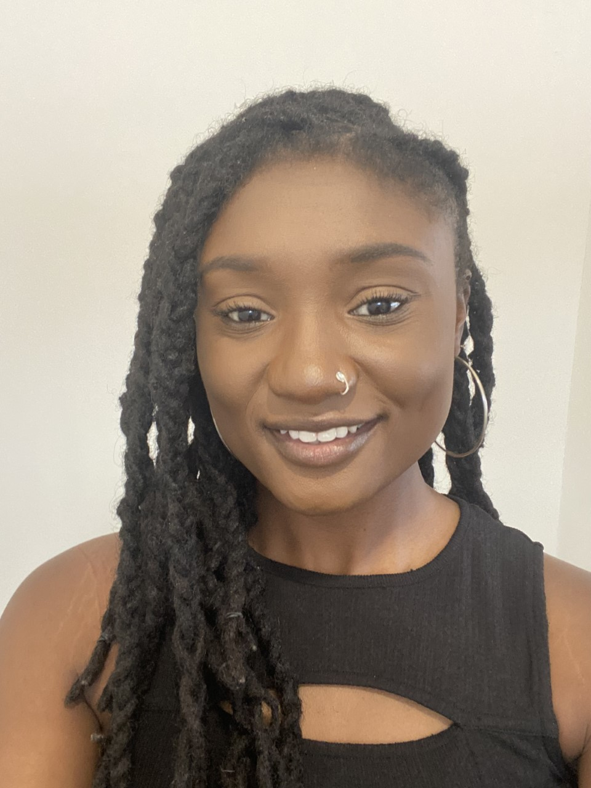
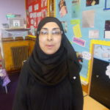
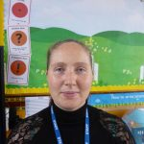
Who are the adults in year 1?
Miss Adu Miss Spillman
Mrs Ali Mrs Barker Emma Bonner Dollie Dare Mrs Ghetau Miss Wagianji

Slide 3
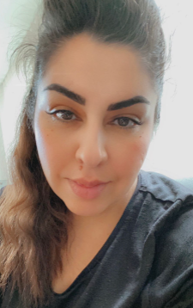
Key Stage One Phase Leader
Mrs Hajir

Slide 4
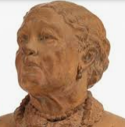
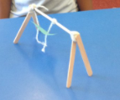
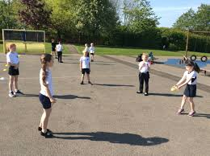
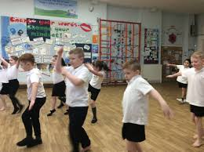
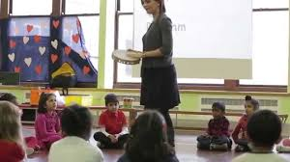
What will your child be learning this year?
English
Maths
Computing
Science
Humanities
Art/DT
PE
RE
PSHE
Music
Music

Slide 5
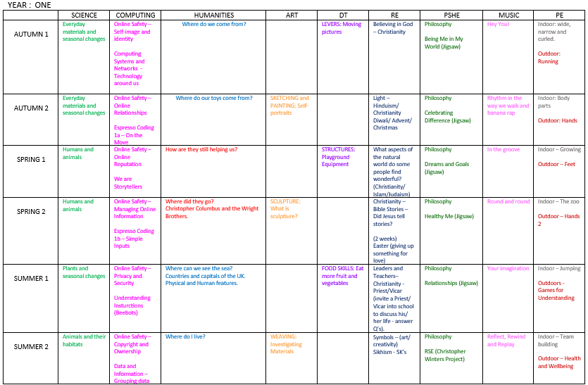
Curriculum overview for Year 1

Slide 6
English overview
Autumn
Spring
Summer

Slide 7
How your child will learn this year.
We have high expectations and high aspirations for all children.
We believe children should have FUN!
Year 1 continue the play based learning approach they were used to in Reception this is to help them have a smooth transition into Year 1 and provide a familiar learning environment.
This approach is adapted to meet the needs of the National curriculum and is in place from September until February.
Children leave Year 1 as happy, independent learners who are ready to take on the challenge of Year 2.

Slide 8
Phonics
Phonics plays a large part in Year 1 and there is an ongoing phonics focus in all lessons. Children have daily Bug Club phonics lessons and will practice decoding to read words and sentences as well as segmenting for spelling.
There will be a meeting to give you more details on Bug Club this term.
At the end of Year 1, all children are required to take part in a phonics screening check. Where they practice reading real and nonsense words using all the phonics they have learnt. There is no pressure and all children build their phonics skill at their own pace with support.
There will be a workshop on Monday 12th September at 2pm. We strongly encourage all families to attend so you can support your child.
Notes:
1. Phonics screening is a statutory requirement, the check in relaxed for children. Have example previous paper jic If chn receive a low grade they will need to retake which we well further support them with.

Slide 9
Reading
Reading is the gateway to all areas of school and remains a top priority in Year 1.
Parents are expected to log on to Bug Club each night and listen to their child read.
Then write a comment in their reading record.
Reading records are checked daily by staff and if homework is not completed then it will be followed up by the class teacher.
Notes:
2. Bug club reading is homework and will support the children in their phonics. We assign books everyday focused on the phonics sound they learnt in phonics today.
3. It’s really important that children have regular access to either a computer or tablet as bug club isn’t efficient on a phone. (If parents bring up tech/wifi issues explain you will pass this on to the leadership team to explore.

Slide 10
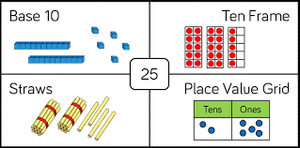
Maths
As a school we follow the White Rose Scheme in maths.
It helps our children build key mathematical skills such as fluency, problem solving and reasoning.
Key skills to practice in the 1st Autumn term
Ordering, counting and sorting numbers
Counting forwards and back in 1’s to 50
Part whole models – Addition and subtraction
Strategies for adding more and adding together
Representing numbers in different ways
Recognise, name and sort 2D and 3D shapes

Slide 11
Uniform
· Smart black shoes - no trainers (unless a PE day)
· Hair styles - must be sensible (no lines
shaved in the sides for boys. No 'extreme hairstyles.’) Hair bands to be school colours and no head bands with ears.
No jewellery to be worn (except small studs no hoops).
No nail varnish to be worn.
· Label EVERYTHING!
· Girls can wear boots with trousers ONLY.
(If they wear a skirt, they need to wear SHOES.)
Notes:
New uniform to be rolled out next year (if parents ask)

Slide 12
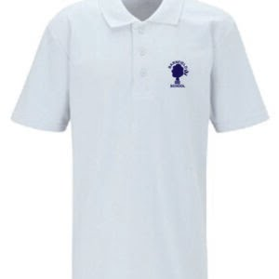
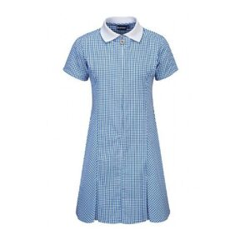
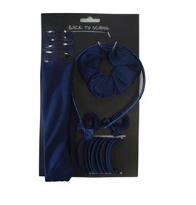
Uniform
summer

Slide 13
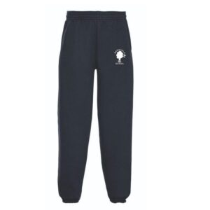
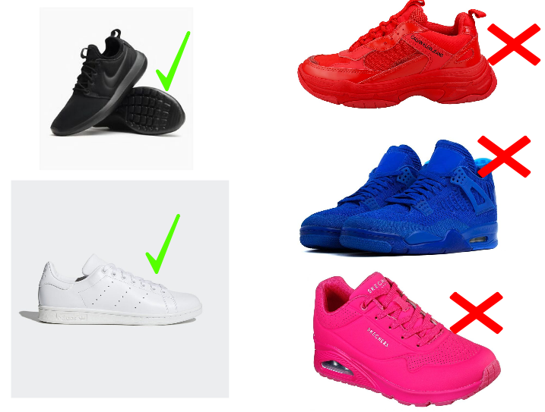
PE
On PE and Games days, all children are expected to wear their PE uniform for the whole day.
This consists of a white t shirt (plain or with school logo)
plain navy shorts and black / white trainers. On colder days, children are able to wear navy PE sweatshirts with the white school logo and navy jogging bottoms (with or without school logo). Please note the sweatshirt for PE/Games is navy with the white school logo.
Your child’s PE days are:
and
winter
Notes:
Children come into school in their PE kits rather than leaving them in school

Slide 14
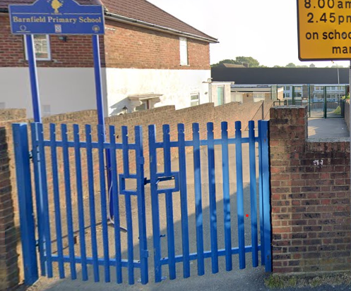
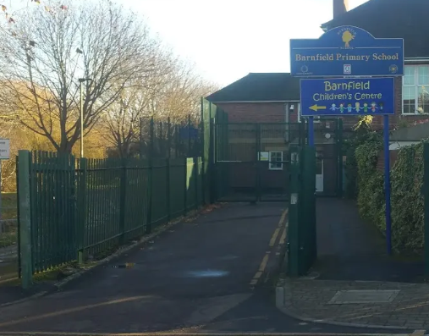
The school day Arrival
The gates will open at 8.40am.
Children need to be in their classrooms by 8.50am
EYFS and Key Stage one pupils enter via the Gaskarth gate.
Key stage 2 pupils enter via the Silkstream gate.
Older children can walk with their siblings via Gaskarth gate.
The first part of the day is essential learning time. The children will practise spelling strategies, times tables, arithmetic and other key skills as soon as they arrive.
We find that children who arrive on time have a calm, settled start to their day and are more ready to learn.

Slide 15
Dismissal
Children need to be collected from their classrooms between 3:15 and 3.20pm.
All children are collected from their classrooms.
It is important that parents with children in both KS2 and early years/KS1 collect from the Silkstream entrance FIRST and follow the one way system which will lead them round to the early years and KS1 classrooms.
As part of our Safeguarding arrangements, children will only be released to adults who we have permission to collect at the end of the day. Please make sure this information is up to date on Arbor.
In an emergency, if someone else needs to collect your child, please call the school office by 2.30pm.
Notes:
As with medication let the office know so we can confirm whether we can administer it.

Slide 16
Online Safety
The internet is amazing. Children can play, learn, create and connect - opening up a whole world of exciting possibilities. But with the digital world changing all the time, how can you make sure your child is staying safe?
- Set up parental controls on your wi-fi connection, phone, tablet and on any gaming devices that they use.
- Talk to your child about staying safe online:
- Agree rules with your child about not meeting up with people they have met online.
- Let them know which websites they are allowed/not allowed to visit.
- Allow them online only for a sensible duration - don't let them play for hours!
- Discuss how they treat others online.
- Make sure they are on child versions of sites like YouTube.
- If your child plays video games, ensure they are appropriate for their age.
Some useful websites are:
https://www.thinkuknow.co.uk/
https://www.nspcc.org.uk/keeping-children-safe/online-safety/

Slide 17
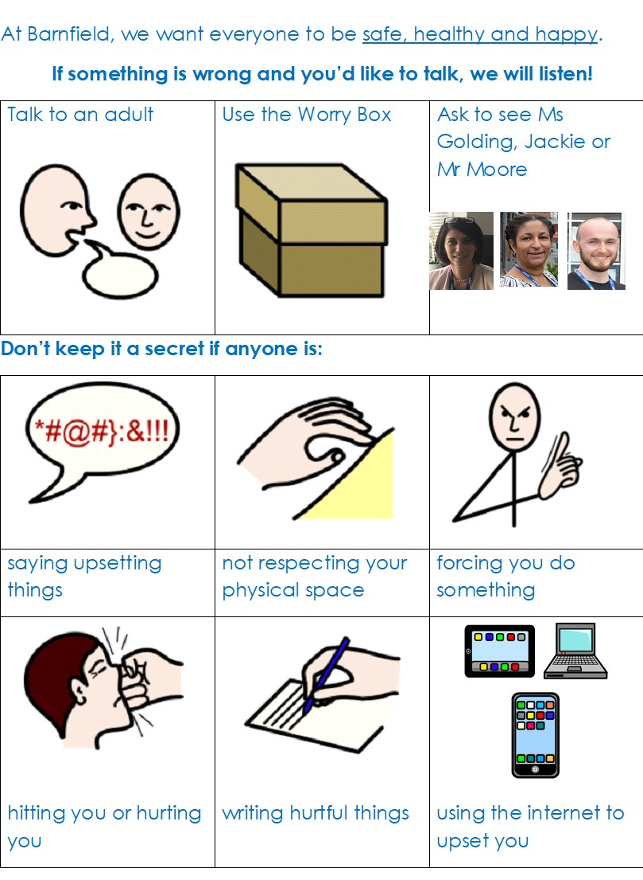
Safeguarding
It is the responsibility of everyone to keep our children safe. If you have a concern about a child please speak to one of our Safeguarding Officers – Ms Golding, Jackie or Mr Moore.

Slide 18
Homework
Phonics

Slide 19
How can parents help?
The best help is by taking an interest in your child’s learning and giving lots of positive encouragement.
Attending all meetings and parents evenings.
Supporting by engaging with home learning.
Talking to us if there is a change at home.
Ensuring children attend:
On time to start the day
Having had breakfast
Having gone to bed at a reasonable time!
With their book bag and labelled water bottle
Please collect children on-time or phone ahead if you are late.

Slide 20
Communication
We try really hard to make sure communication is regular and up to date.
We use Arbor as our main platform to communicate with parents and carers. All letters, newsletters and permission for trips are sent via Arbor.
Please make sure you have logged into Arbor and checked all your details are correct, including your emergency contact details and contact numbers. We require at least three contacts for each child. You can download the free Arbor App straight to your mobile phone.
If you need help with this, please speak to the Office or Jackie.
We regularly send text reminders – therefore it is important your contact details are up to date.
Please read the newsletter weekly and look at the school website – this contains lots of important information and dates. https://barnfieldschool.co.uk/

Slide 21
Contacting your child’s teacher
If you need to get in touch with your child’s teacher, please call or email the office and they will pass on your message.
The teacher will then get back to you within working hours.
Alternatively speak to them at the end of the day or book a meeting with them.

