Slide 1
Welcome to Year 2
Parent Meeting 2022

Slide 2
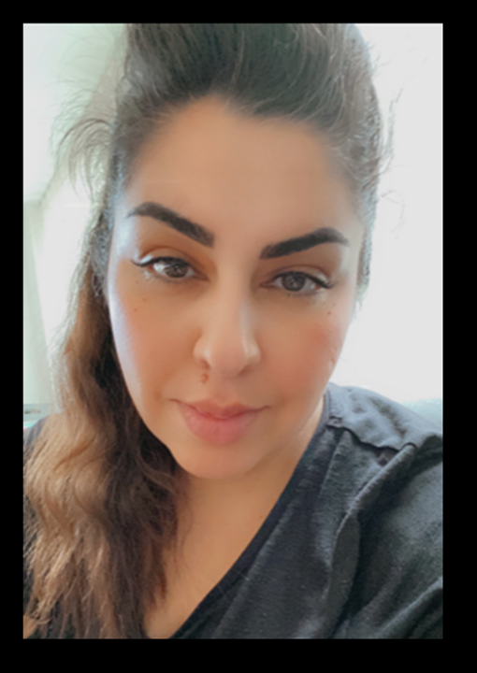
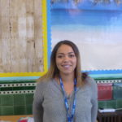
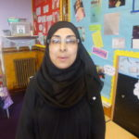
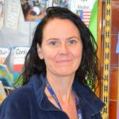
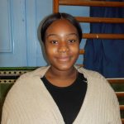
Who are the adults in year 2?
Year 2 Teacher
KS1 Phase Leader
Humanities Leader
Phonics Leader
Year 2 Teacher
EAL Leader
Ms. Ali
HLTA
Ms. Shaw
Support Staff
Dolly
Support Staff
Ms. Wagjiani
Support Staff

Slide 3
Key Stage One Phase Leader
Mrs Hajir

Slide 4
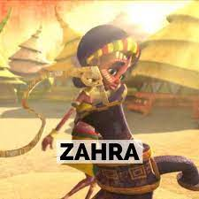
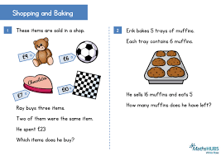
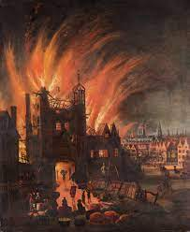
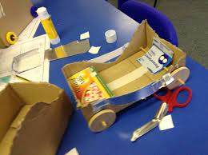
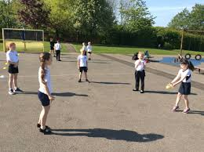
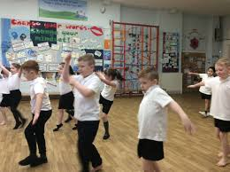
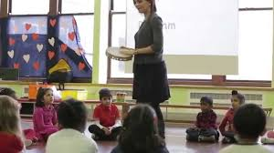
What will your child be learning this year?
English
Maths
Computing
Science
Humanities
Art/DT
PE
RE
PSHE
Music
Music

Slide 5
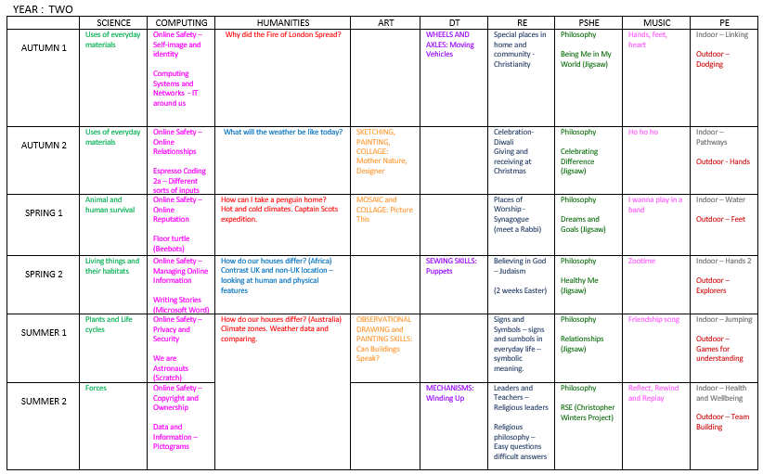
Curriculum overview for Year 2

Slide 6
English overview
Autumn
Spring
Summer

Slide 7
Year 2
We have high expectations and high aspirations for all children.
We believe that our children can all be successful through hard work, determination and a positive attitude.
We work tirelessly to ensure our children are given knowledge and skills so they are able to reach their full potential.
We aim to keep the children focused, whilst still enjoying school.
We ensure our children experience their learning in a variety of styles.

Slide 8
Year 2
SATs are now called National Curriculum Assessments
They are taken at the end of Key Stage 1 (at age 6/7) and at the end of Key Stage 2 (at age 10/11).
Testing for Year Two takes place during the month of May.
The tests will cover English reading, English grammar, punctuation and spelling, and Mathematics.
An information meeting to explore this further will take place later in the year.

Slide 9
Phonics
Phonics plays a large part in Year 2 and there is an ongoing phonics focus in all lessons. Children have daily Bug Club phonics lessons and will practice decoding to read words and sentences as well as segmenting for spelling.
Parents are expected to log on to Bug Club each night and listen to their child read.
Then write a comment in their reading record.
Reading records are checked daily by staff and if homework is not completed then it will be followed up by the class teacher.
There will be a workshop on Monday 12th September at 2pm. We strongly encourage all families to attend so you can support your child.

Slide 10
Reading
Reading is the gateway to all areas of school and remains a top priority in Year 2.
Children will read in school everyday and we will continue to teach phonics until we feel children are secure. This will then become support for spelling where we teach spelling rules.
We introduce comprehension skills and use these throughout the curriculum.
We are committed to developing a love of reading for children and have story time each day with books we love.

Slide 11
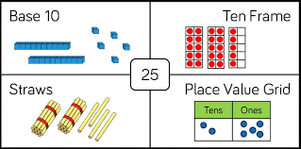
Maths
As a school we follow the White Rose Scheme in maths.
It helps our children build key mathematical skills such as fluency, problem solving and reasoning.
Key skills to practice in Autumn
Partitioning
2,5,10 timetable and division facts
Odd and even numbers
Ordering and sequencing numbers
Representing numbers in different ways

Slide 12
Uniform
· Smart black shoes - no trainers (unless a PE day)
· Hair styles - must be sensible (no lines
shaved in the sides for boys. No 'extreme hairstyles.’) Hair bands to be school colours and no head bands with ears.
No jewellery to be worn (except small studs no hoops).
No nail varnish to be worn.
· Label EVERYTHING!
· Girls can wear boots with trousers ONLY.
(If they wear a skirt, they need to wear SHOES.)

Slide 13
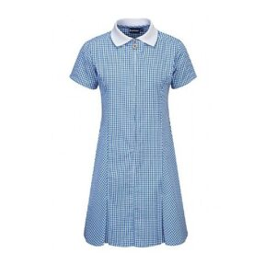
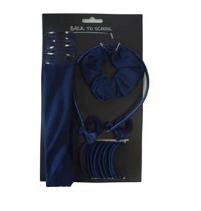
Uniform
summer

Slide 14
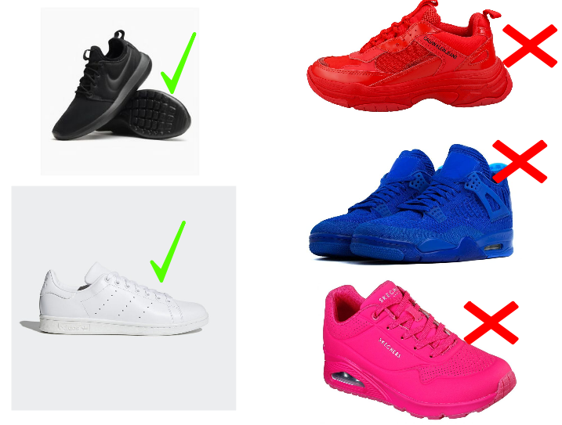
PE
On PE and Games days, all children are expected to wear their PE uniform for the whole day.
This consists of a white t shirt (plain or with school logo)
plain navy shorts and black / white trainers. On colder days, children are able to wear navy PE sweatshirts with the white school logo and navy jogging bottoms (with or without school logo). Please note the sweatshirt for PE/Games is navy with the white school logo.
Your child’s PE days are:
and
winter

Slide 15
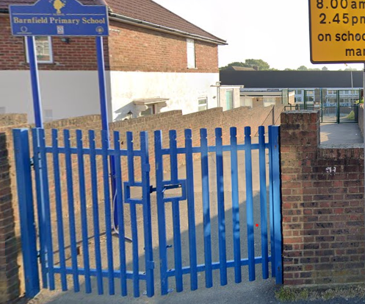
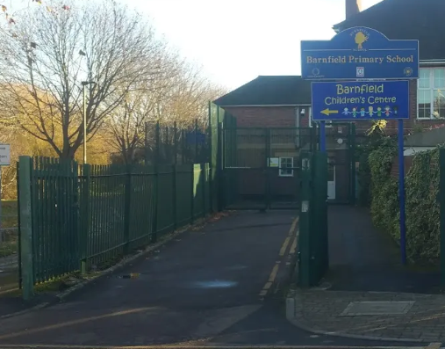
The school day Arrival
The gates will open at 8.40am.
Children need to be in their classrooms by 8.50am
EYFS and Key Stage one pupils enter via the Gaskarth gate.
Key stage 2 pupils enter via the Silkstream gate.
Older children can walk with their siblings via Gaskarth gate.
The first part of the day is essential learning time. The children will practise spelling strategies, times tables, arithmetic and other key skills as soon as they arrive.
We find that children who arrive on time have a calm, settled start to their day and are more ready to learn.

Slide 16
Dismissal
Children need to be collected from their classrooms between 3:15 and 3.20pm.
All children are collected from their classrooms.
It is important that parents with children in both KS2 and early years/KS1 collect from the Silkstream entrance FIRST and follow the one way system which will lead them round to the early years and KS1 classrooms.
As part of our Safeguarding arrangements, children will only be released to adults who we have permission to collect at the end of the day. Please make sure this information is up to date on Arbor.
In an emergency, if someone else needs to collect your child, please call the school office by 2.30pm.

Slide 17
Online Safety
The internet is amazing. Children can play, learn, create and connect - opening up a whole world of exciting possibilities. But with the digital world changing all the time, how can you make sure your child is staying safe?
- Set up parental controls on your wi-fi connection, phone, tablet and on any gaming devices that they use.
- Talk to your child about staying safe online:
- Agree rules with your child about not meeting up with people they have met online.
- Let them know which websites they are allowed/not allowed to visit.
- Allow them online only for a sensible duration - don't let them play for hours!
- Discuss how they treat others online.
- Make sure they are on child versions of sites like YouTube.
- If your child plays video games, ensure they are appropriate for their age.
Some useful websites are:
https://www.thinkuknow.co.uk/
https://www.nspcc.org.uk/keeping-children-safe/online-safety/

Slide 18
Safeguarding
It is the responsibility of everyone to keep our children safe. If you have a concern about a child please speak to one of our Safeguarding Officers – Ms Golding, Jackie or Mr Moore.

Slide 19
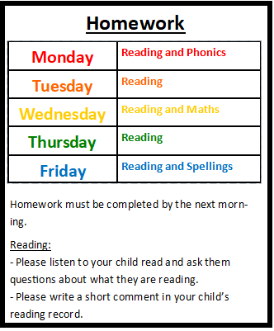
Homework
The year 2 common exception words are words children in year 2 should be able to spell and read correctly.
Children are expected to learn their spellings each week and show that they can apply these in their writing.

Slide 20
How can parents help?
The best help is by taking an interest in your child’s learning and giving lots of positive encouragement.
Attending all meetings and parents evenings.
Supporting by engaging with home learning.
Talking to us if there is a change at home.
Ensuring children attend:
On time to start the day
Having had breakfast
Having gone to bed at a reasonable time!
With their book bag and labelled water bottle
Please collect children on-time or phone ahead if you are late.

Slide 21
Communication
We try really hard to make sure communication is regular and up to date.
We use Arbor as our main platform to communicate with parents and carers. All letters, newsletters and permission for trips are sent via Arbor.
Please make sure you have logged into Arbor and checked all your details are correct, including your emergency contact details and contact numbers. We require at least three contacts for each child. You can download the free Arbor App straight to your mobile phone.
If you need help with this, please speak to the Office or Jackie.
We regularly send text reminders – therefore it is important your contact details are up to date.
Please read the newsletter weekly and look at the school website – this contains lots of important information and dates. https://barnfieldschool.co.uk/

Slide 22
Contacting your child’s teacher
If you need to get in touch with your child’s teacher, please call or email the office and they will pass on your message.
The teacher will then get back to you within working hours.
Alternatively speak to them at the end of the day or book a meeting with them.

