Slide 1
Welcome to Year 6
Parent Meeting 2022

Slide 2
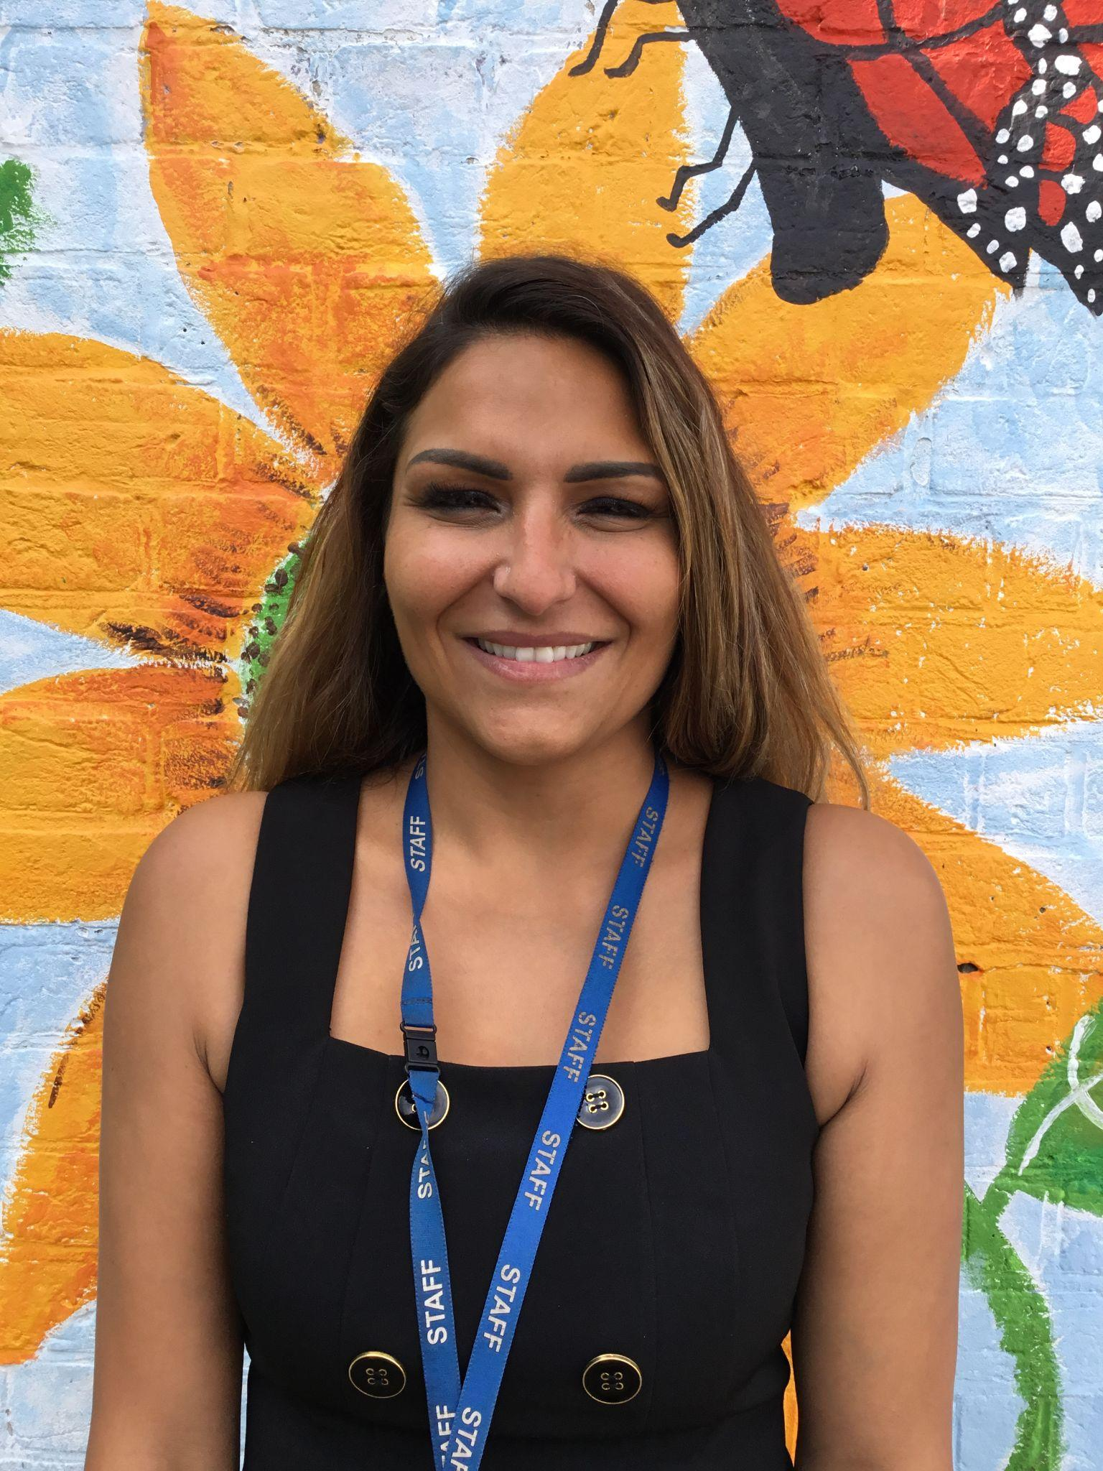
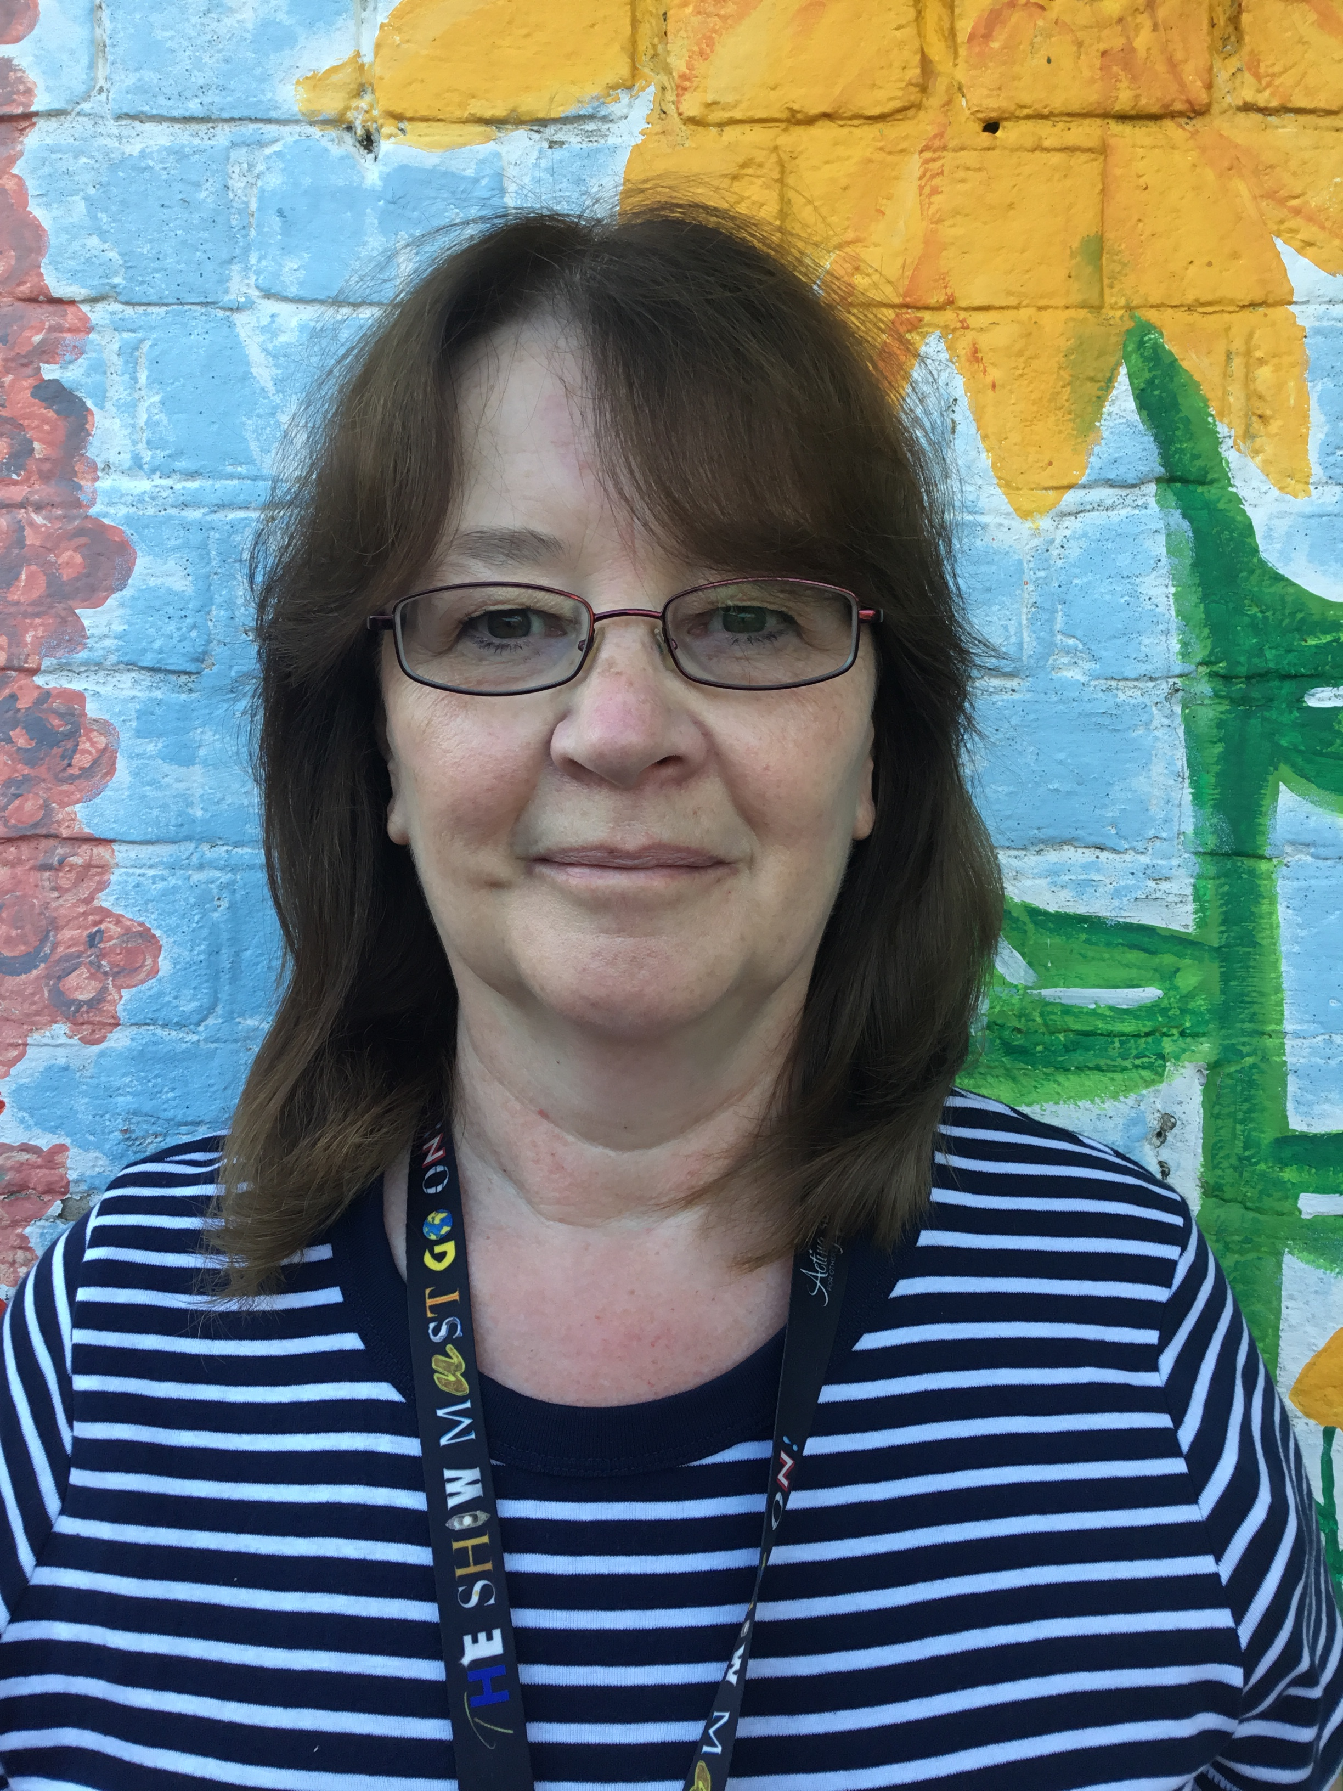
Who are the adults in year 6?
KATRINA VESSEY
YEAR 6 TEACHER, PSHE LEADER, MENTAL FIRST AIDER
HARPREET PAREKH
YEAR 6 TEACHER & DT LEADER
Linda dawson

Slide 3
Upper Key Stage 2 Phase Leader
Miss Vessey

Slide 4
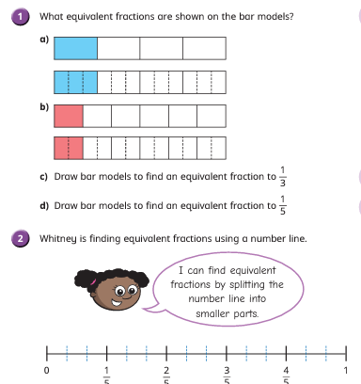
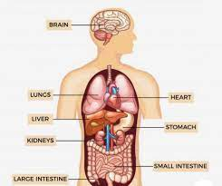
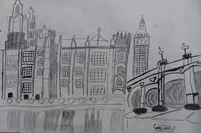
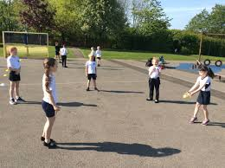
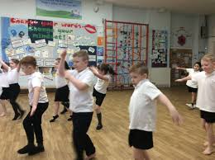
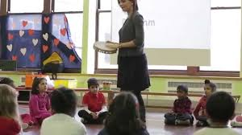
What will your child be learning this year?
English
Maths
Computing
Science
Humanities
Art/DT
PE
RE
PSHE
Music
French
Music

Slide 5
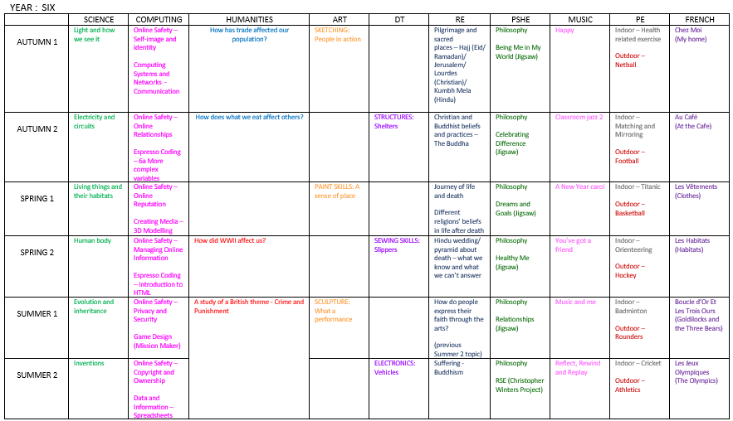
Curriculum overview for Year 6

Slide 6
English overview
Autumn
Spring
Summer

Slide 7
Important dates
Trips –Residential yet to be confirmed- if not an activity day at Wild forest.
Trip linked to compass for life and religious trips.
Workshops- police visit, e-safety, TFL using public transport.
SATs - The 2023 KS2 SATs will take place in the week commencing 8th May 2023. The tests will take place over four days
Secondary transfer deadline coming up this half term. Speak to Jackie if you have any questions.

Slide 8
Year 6
We have high expectations and high aspirations for all children.
We believe that our children can all be successful through hard work, determination and a positive attitude.
We work tirelessly to ensure our children are given knowledge and skills so they are able to reach their full potential.
We aim to keep the children focused, whilst still enjoying school.
We ensure that our children develop independence and take on responsibility to prepare them for secondary school.

Slide 9
Year 6
Children must know Y3/4 words as well and Y5/6 and be able to spell them in independent writing.
There is an emphasis on vocabulary in reading and writing.
Grammatical terminology and apply it in independent writing.
Secure formal methods of calculation.
SATs
SATs are the Standardised Assessment Tests that are given to children at the end of Key Stage 2.
The SATs papers consist of:
Spelling, punctuation and grammar
Reading
Maths Arithmetic and Reasoning)
Writing is assessed using evidence collected throughout Year 6. There is no Year 6 SATs writing test.

Slide 10
Reading records
Children are expected to log on to Bug Club at least three times a week for at least 15 minutes.
Children must complete reading records (date, book, page numbers read, comment/signature)
Try to listen to your child read at least once a week – practise reading aloud and write a comment in their reading record.
Reading records are checked by staff and if homework is not completed then it will be followed up by the class teacher.

Slide 11
Reading
Reading is the gateway to all areas of school and remains a top priority in Year 6.
We are committed to developing a love of reading for children and have story time each day with books we love.
In Year 6 children will be taught to increase their familiarity with a wide range of books, including myths, legends and traditional stories, modern fiction, fiction from our literary heritage, and books from other cultures and traditions
Inference: This is an interpretation that goes beyond the literal information given.
Deduction: this is an understanding based on the evidence given in a text.
It is important that your child understands what they are reading and can begin to use the text to evidence this understanding.

Slide 12
Maths
As a school we follow the White Rose Scheme in maths.
It helps our children build key mathematical skills such as fluency, problem solving and reasoning.
Key skills to practice in Autumn
Partitioning and place value
Multiples, factors and square numbers
Mental calculations and estimations
Fractions
Metric and imperial measures

Slide 13
What will your child be learning this year?
Literacy
The London Eye Mystery
Goodnight Mr Tom
Clockwork
Shackleton’s Journey
Macbeth
Kensuke’s Kingdom
Grammar
Comprehension
Numeracy
Numbers to 10, 000, 000
Calculating with 4 digit numbers
Long and short division
Fractions: adding, subtracting, multiplying and dividing
Decimals and percentages
Equations and formulae
Area of a triangle
Drawing pie charts
How we see things/Electricity Living things/ Human body
How trade has affected population / Crime and Punishment
People in Action/ Shelters/ Slippers
Role of the Mosque/ Special times and buildings/ Sikhism
Google classroom/ Coding/ Game design

Slide 14
Uniform
· Smart black shoes - no trainers (unless a PE day)
· Hair styles - must be sensible (no lines
shaved in the sides for boys. No 'extreme hairstyles.’) Hair bands to be school colours and no head bands with ears.
No jewellery to be worn (except small studs no hoops).
No nail varnish to be worn.
· Label EVERYTHING!

Slide 15
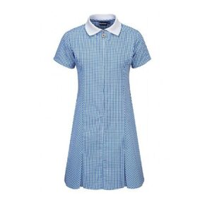
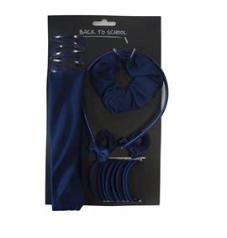
White school shirt with the school tie and a navy v neck jumper.
Pupils wear grey trousers / skirt on their bottom part. All children must wear plain black sensible school shoes. Children may wear sensible black ankle boots in the colder weather. Girls are able to wear plain dark hijabs with their winter uniform and a white hijab with the summer uniform.
summer

Slide 16
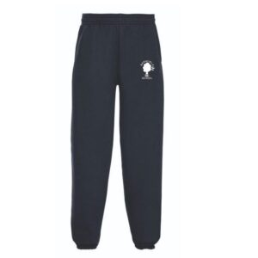
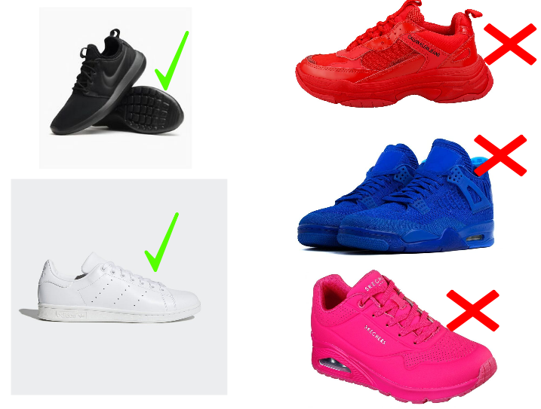
PE
On PE and Games days, all children are expected to wear their PE uniform for the whole day.
This consists of a white t shirt (plain or with school logo)
plain navy shorts and black / white trainers. On colder days, children are able to wear navy PE sweatshirts with the white school logo and navy jogging bottoms (with or without school logo). Please note the sweatshirt for PE/Games is navy with the white school logo.
Your child’s PE days are:
Wednesday and Thursday
winter

Slide 17
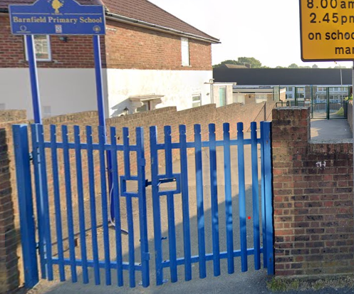
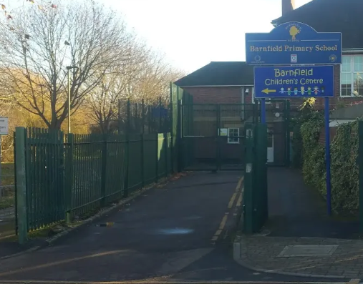
The school day Arrival
The gates will open at 8.40am.
Children need to be in their classrooms by 8.50am
EYFS and Key Stage one pupils enter via the Gaskarth gate.
Key stage 2 pupils enter via the Silkstream gate.
Older children can walk with their siblings via Gaskarth gate.
The first part of the day is essential learning time. The children will practise spelling strategies, times tables, arithmetic and other key skills as soon as they arrive.
We find that children who arrive on time have a calm, settled start to their day and are more ready to learn.

Slide 18
Dismissal
Children need to be collected from their classrooms between 3:15 and 3.20pm.
All children are collected from their classrooms.
It is important that parents with children in both KS2 and early years/KS1 collect from the Silkstream entrance FIRST and follow the one way system which will lead them round to the early years and KS1 classrooms.
As part of our Safeguarding arrangements, children will only be released to adults who we have permission to collect at the end of the day. Please make sure this information is up to date on Arbor.
In an emergency, if someone else needs to collect your child, please call the school office by 2.30pm.

Slide 19
Online Safety
The internet is amazing. Children can play, learn, create and connect - opening up a whole world of exciting possibilities. But with the digital world changing all the time, how can you make sure your child is staying safe?
- Set up parental controls on your wi-fi connection, phone, tablet and on any gaming devices that they use.
- Talk to your child about staying safe online:
- Agree rules with your child about not meeting up with people they have met online.
- Let them know which websites they are allowed/not allowed to visit.
- Allow them online only for a sensible duration - don't let them play for hours!
- Discuss how they treat others online.
- Make sure they are on child versions of sites like YouTube.
- If your child plays video games, ensure they are appropriate for their age.
Some useful websites are:
https://www.thinkuknow.co.uk/
https://www.nspcc.org.uk/keeping-children-safe/online-safety/

Slide 20
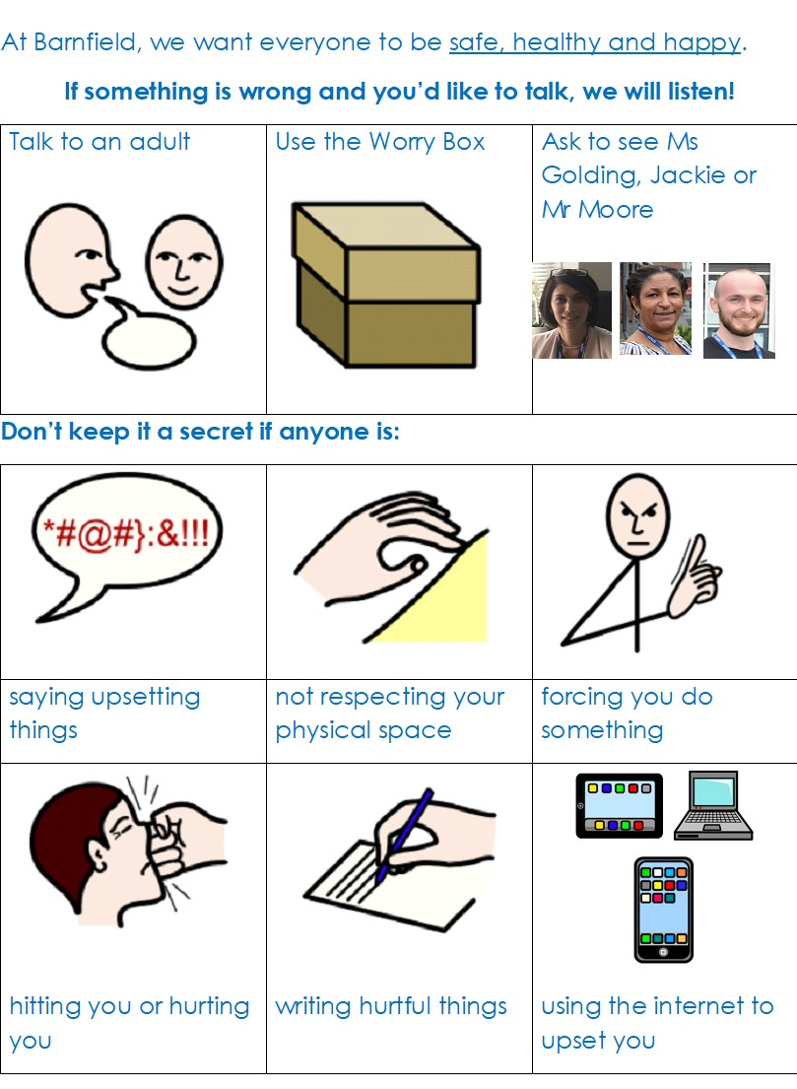
Safeguarding
It is the responsibility of everyone to keep our children safe. If you have a concern about a child please speak to one of our Safeguarding Officers – Ms Golding, Jackie or Mr Moore.

Slide 21
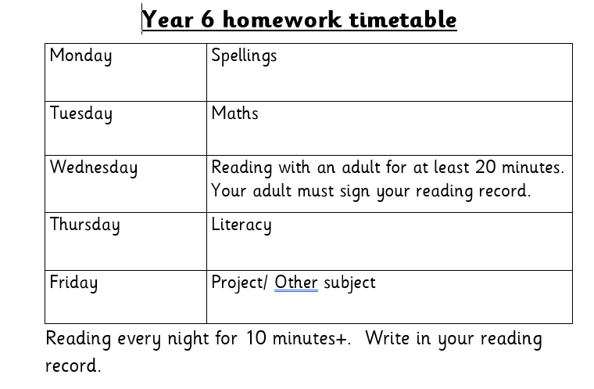
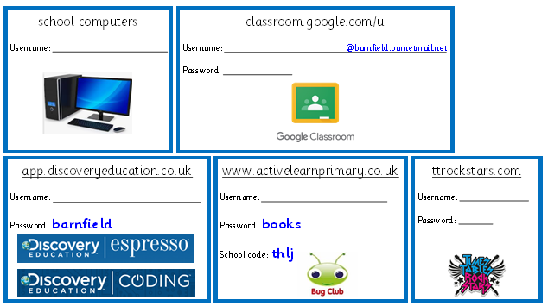
Homework
Reading is an ongoing home learning process and children need to read at home at least 3 times a week.

Slide 22
How can parents help?
The best help is by taking an interest in your child’s learning and giving lots of positive encouragement.
Attending all meetings and parents evenings.
Supporting by engaging with home learning.
Talking to us if there is a change at home.
Ensuring children attend:
On time to start the day
Having had breakfast
Having gone to bed at a reasonable time!
With their book bag and labelled water bottle
Please collect children on-time or phone ahead if you are late.

Slide 23
Communication
We try really hard to make sure communication is regular and up to date.
We use Arbor as our main platform to communicate with parents and carers. All letters, newsletters and permission for trips are sent via Arbor.
Please make sure you have logged into Arbor and checked all your details are correct, including your emergency contact details and contact numbers. We require at least three contacts for each child. You can download the free Arbor App straight to your mobile phone.
If you need help with this, please speak to the Office or Jackie.
We regularly send text reminders – therefore it is important your contact details are up to date.
Please read the newsletter weekly and look at the school website – this contains lots of important information and dates. https://barnfieldschool.co.uk/

Slide 24
Contacting your child’s teacher
If you need to get in touch with your child’s teacher, please call or email the office and they will pass on your message.
The teacher will then get back to you within working hours.
Alternatively speak to them at the end of the day or book a meeting with them.

