Slide 1
Welcome
Ms Lisa Golding
Head Teacher

Slide 2
At Barnfield Primary, our intent is to provide a curriculum framework which offers exciting and meaningful learning opportunities. We want our pupils to be inspired and motivated, enabling them to be the best they possibly can.
Our holistic approach to learning is underpinned by our core values that aim to unlock every child’s intellectual, emotional, social, physical, artistic, creative and spiritual potential. We recognise the importance of developing these attributes in helping to ensure our young people flourish within a broad and balanced setting

Slide 3
Our core values are:
​
1. Creative me
2. Curious me
3. Healthy me
4. Empathetic me
5. Ambitious me
At Barnfield we
‘Dream. Believe. Achieve’.

Slide 4
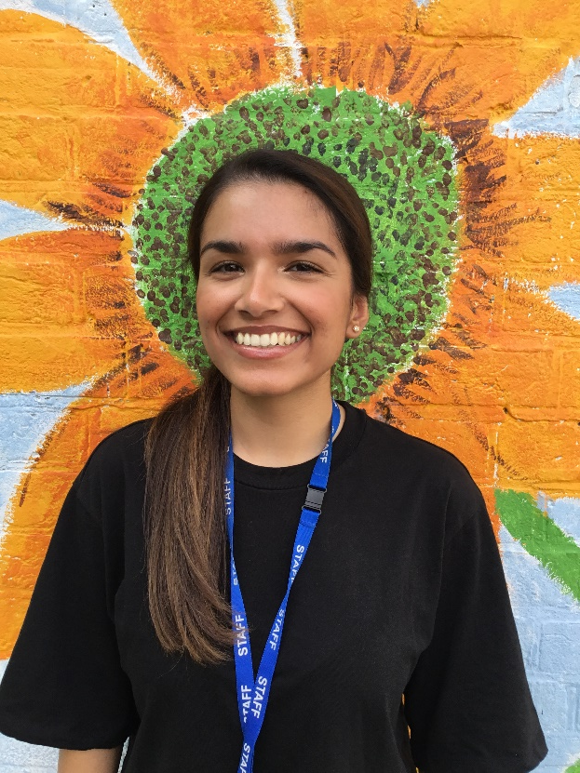
Foundation Stage Staff
Ms Wojacki Miss Ali
Class Teacher Class Teacher

Slide 5
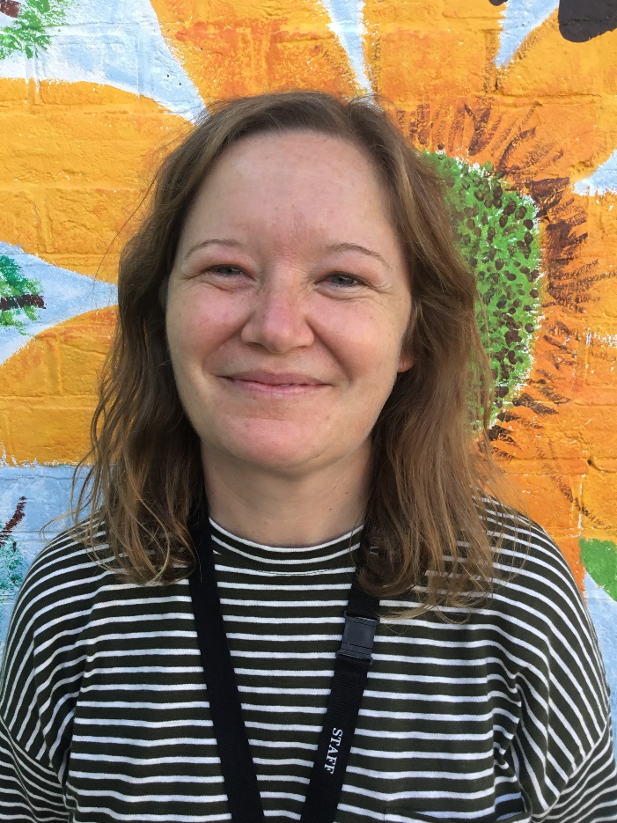
Miss Biggs Sally Foundation Stage Lead

Slide 6
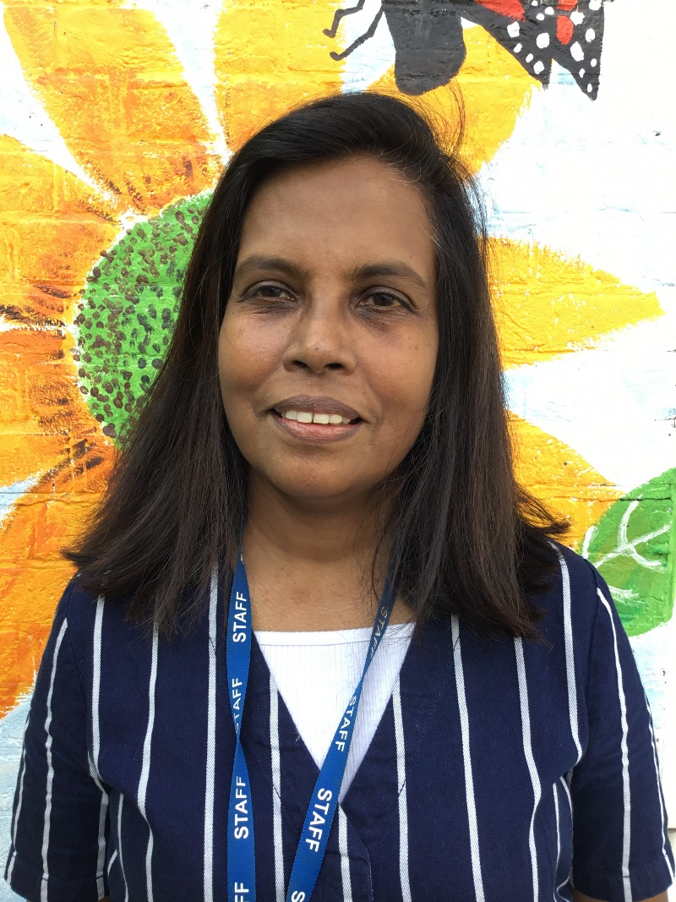
Lasanthie

Slide 7
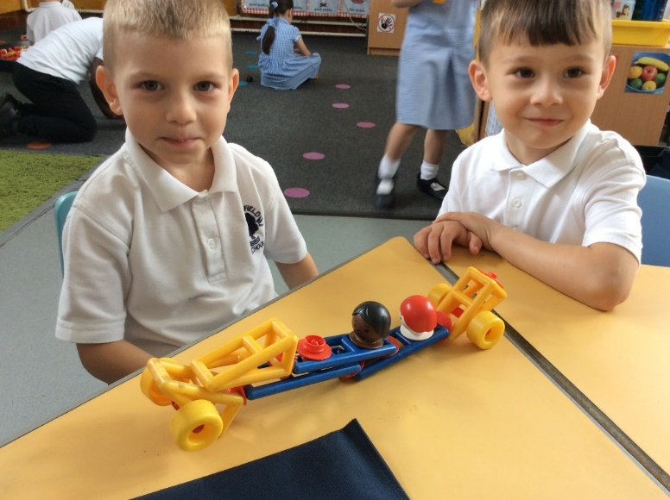
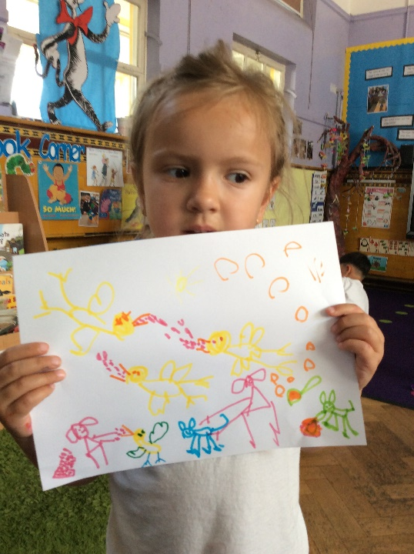
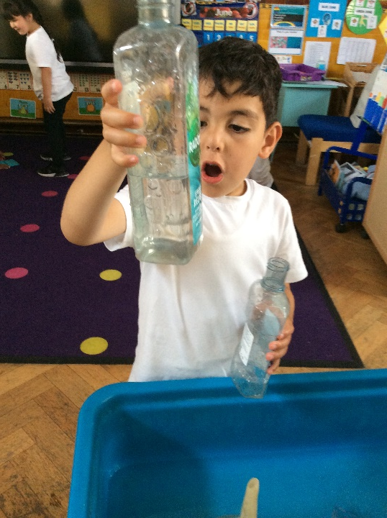
At Barnfield…
We work hard to achieve our best and take pride in all our successes.
.

Slide 8
Baseline
During the first six weeks of the Autumn term the children will have Baseline assessment.
This is a new assessment and the children will work individually with an adult.
This information is used by the government to track the year group and not individual children.

Slide 9
Foundation Stage Curriculum
In Reception we focus on the 7 areas of learning
Communication and Language
Physical Development
Personal, Social and Emotional Development
Literacy (Reading and Writing)
Mathematical Development
Knowledge and Understanding
Expressive Arts and Design

Slide 10
Foundation Stage Profile
Children work towards Early Learning Goals
Children work towards Early Learning Goals, which are the expectations for most children to aim towards during Reception year.
By the end of Reception, some children will have achieved or some will still be working towards them.
We work in partnership with you to help ensure your child reaches their potential.
Parents receive information throughout the year regarding the best way to support your child.

Slide 11
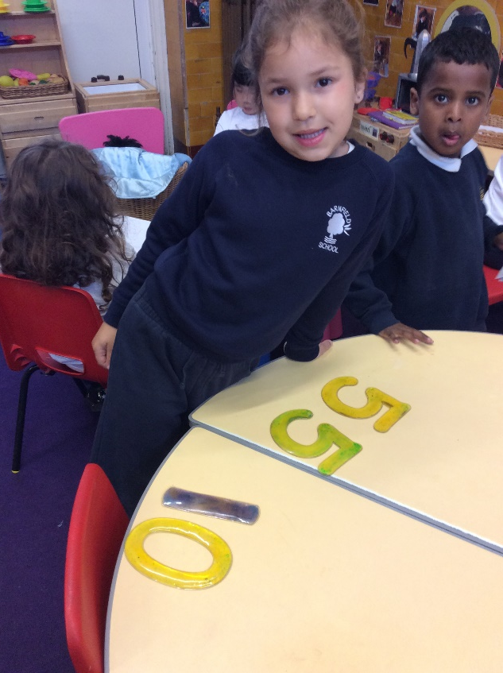
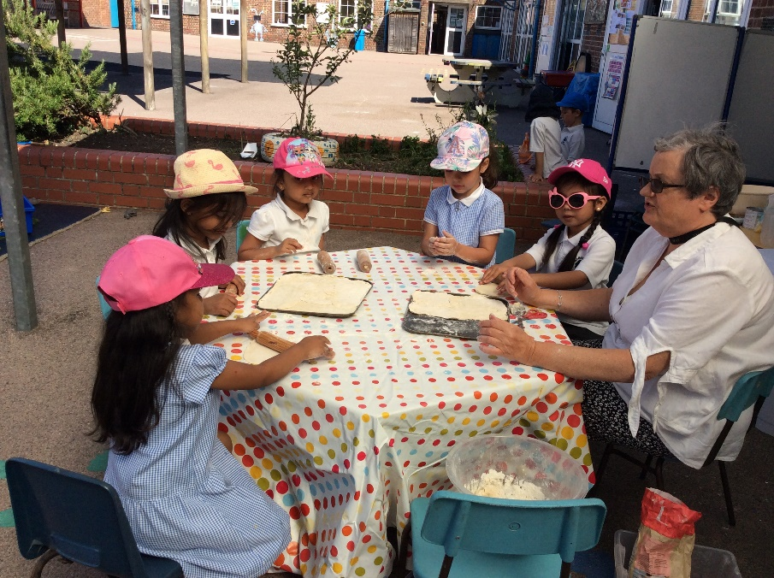
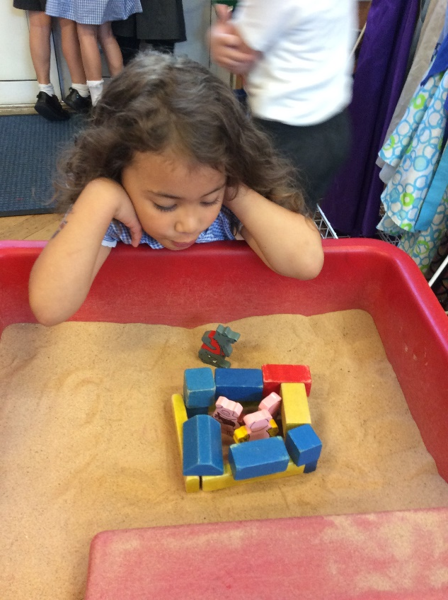
A typical day in Reception

Slide 12
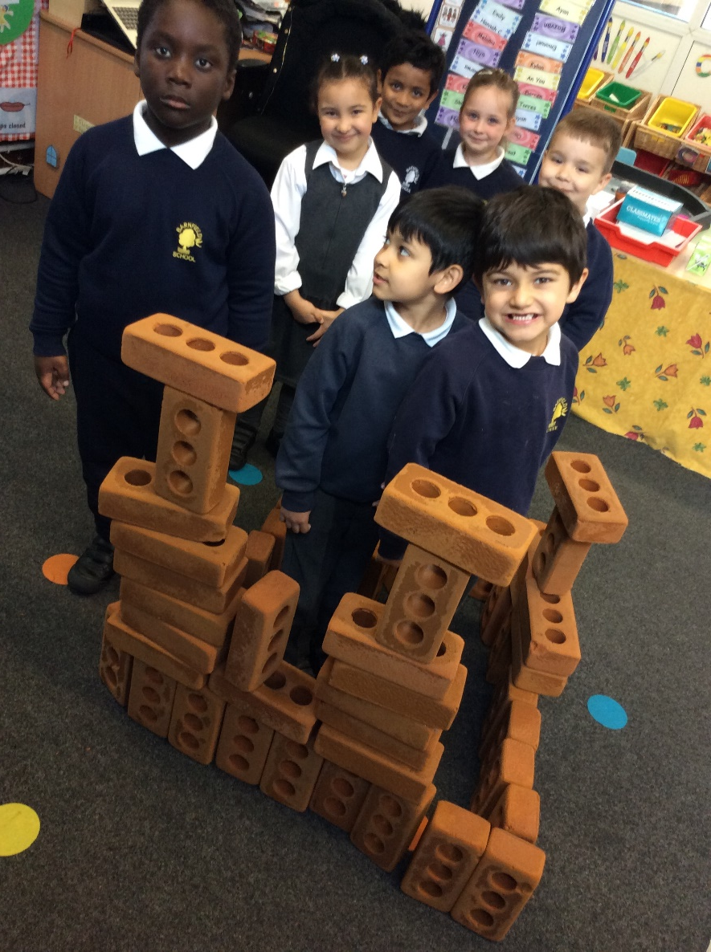
At Barnfield…
We help each other to believe in our abilities and skills so that we do our very best and grow up facing the future with confidence.

Slide 13
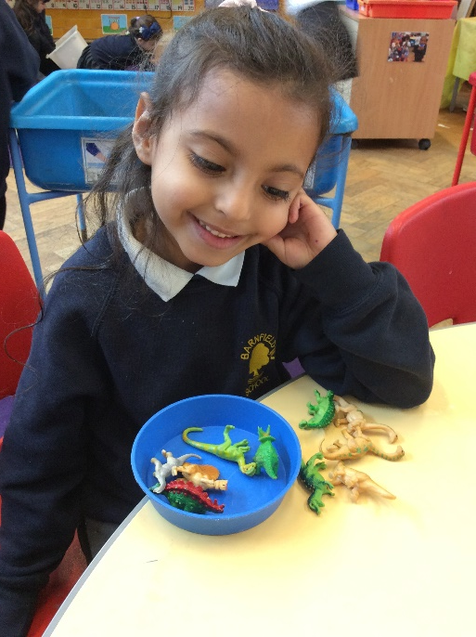
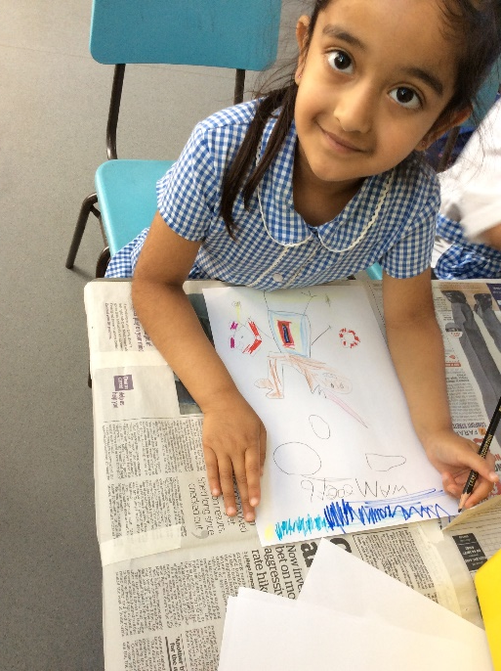
Learning Activities
Each morning the children will take part in small group maths sessions and small group literacy focus sessions.
They will also have opportunities to work independently, applying the skills that they have learnt, in our structured play areas inside and outdoors.

Slide 14
Structured and Independent play
A lot of the learning in Reception takes place through play both indoors and outside.
Role play area
Writing table
Workshop
Music area
ICT
Construction and small world
Water
Sand
Dough
Paint
Maths area
Outside Area

Slide 15
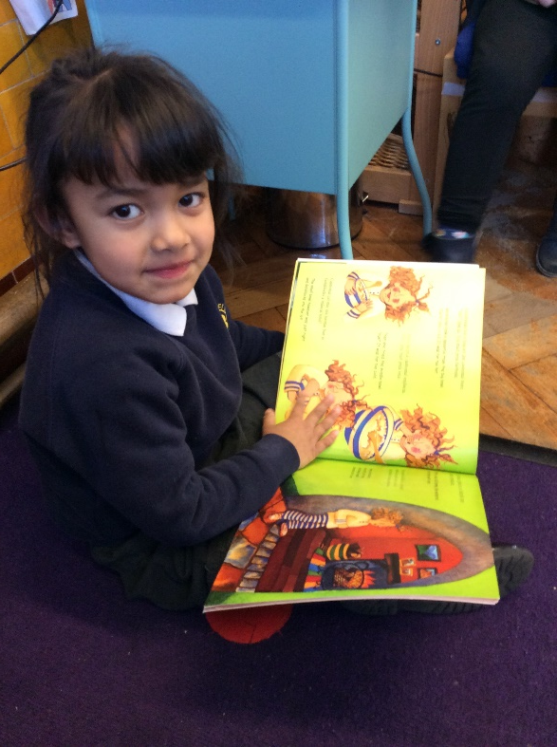
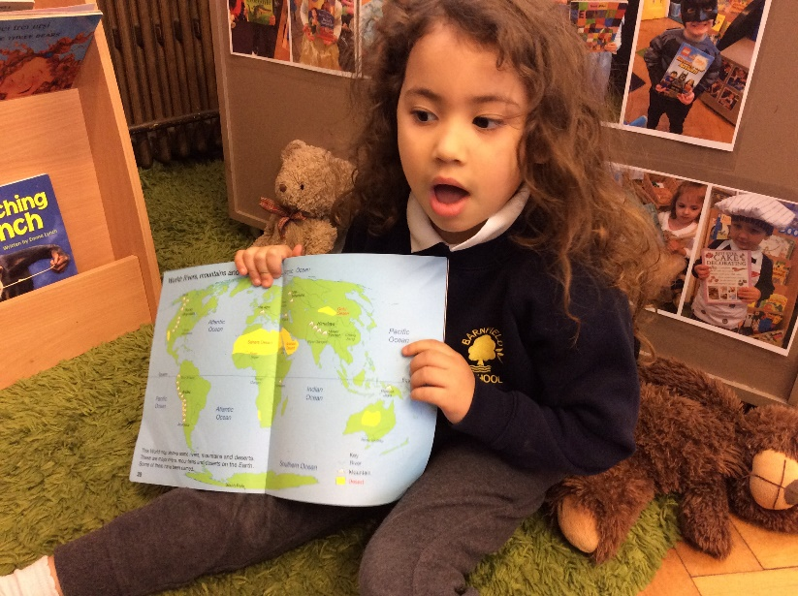
Literacy based learning –Reading and Writing
Develop a love of books
Phonics
Reading book
Reading Records
Cursive handwriting
.

Slide 16
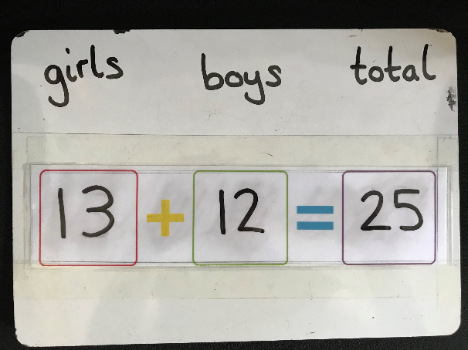
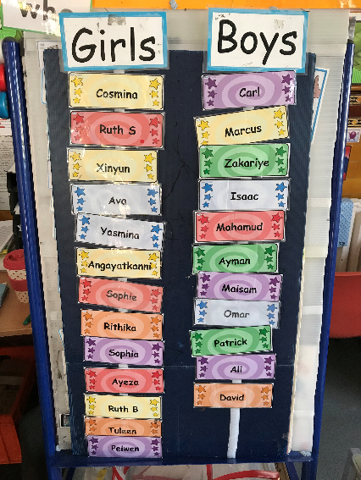
Maths in Reception

Slide 17
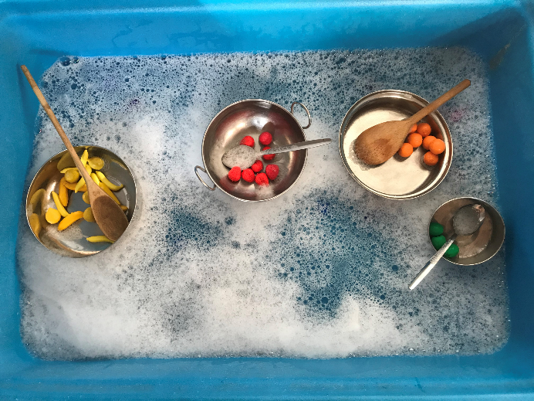
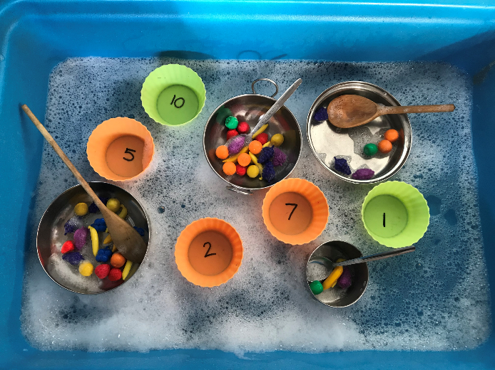
Learning through play in the classroom

Slide 18
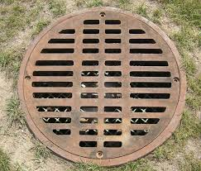
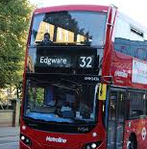
Maths fun over the summer holiday
Go on shape hunts around the local area.
Go on number hunts around the local area.

Slide 19
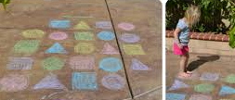
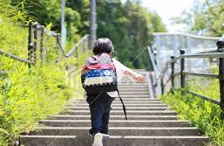
Maths fun over the summer holiday
Draw shapes in chalk on the pavement.
Set counting challenges. How many stairs in this building?

Slide 20
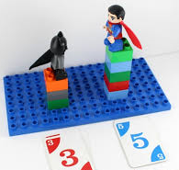
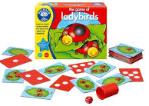
Maths fun over the summer holiday
Create opportunities to compare and measure objects.
Play good quality counting games that encourage turn taking

Slide 21
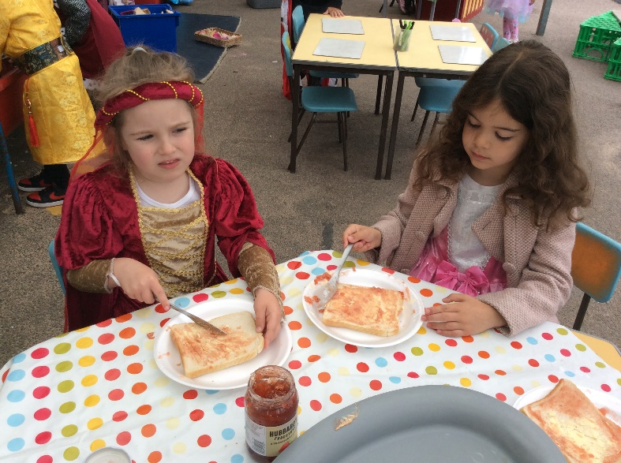
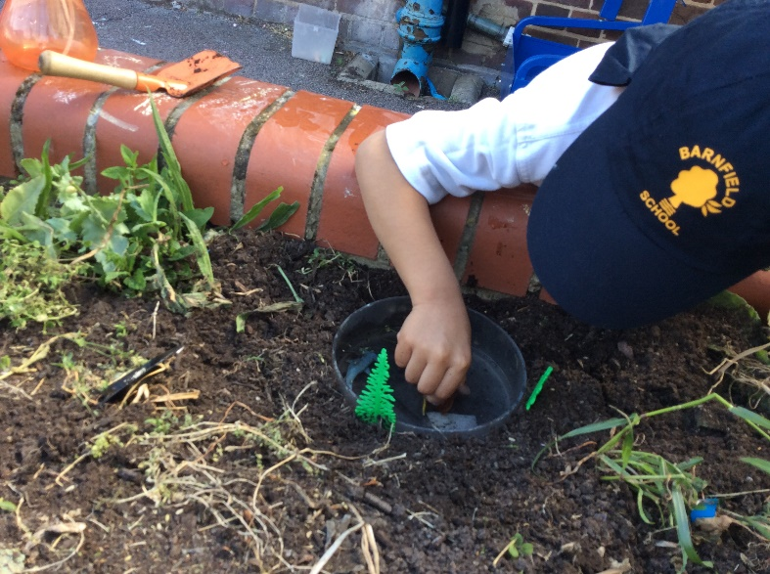
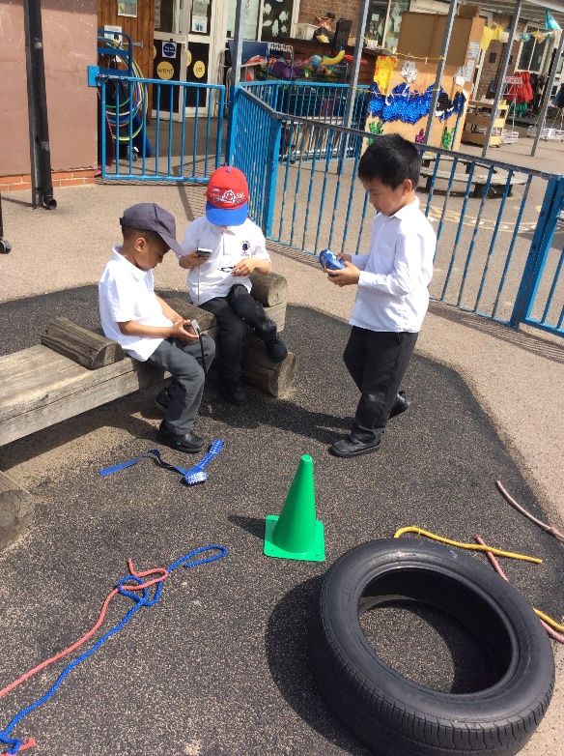
Outdoor Provision
We spend a lot of time outside!

Slide 22
Lunch Time
Our experienced team will look after your child during the lunch break.
Since September 2015 all EYFS and KS1 children are entitled to a free school meal. The children will eat together in the dining room. (see form in your pack)
The rest of the lunch break is spent outside in the playground. If it is raining the children remain in their classrooms.

Slide 23
Toilet issues
If your child has any toilet issues. Please let us know.
Please provide a bag containing named, spare school uniform, underwear and wipes. The bag should be left in school so that your child always has his/her own clothing available.

Slide 24
We are proud to be part of the Barnfield Family and Burnt Oak community. We want to work with families and friends, to make the place where we live a happy and safe environment.
We celebrate our differences!

Slide 25
School Trips and wider experiences
A fantastic way of gaining experiences and improving confidence and social awareness.
High child adult ratio
Detailed risk assessments
Special visitors
Workshops
Themed weeks in school

Slide 26
Wrap around care
Breakfast Club and
After school Club

Slide 27
Beginning and end of day
If you have older children in KS2, enter the school from Silkstream road, collect the older children first and follow the one way system to collect children in KS1 and Reception.
If you only have children in KS1 or Reception use the Gaskarth Road gate.

Slide 28
Relationship Policy
Key focus in school on developing strong relationships
Respectful
Responsible
Ready to learn
Standards of Behaviour All members of our school community have the right to:
∙ feel secure and safe
∙ feel happy and be treated with kindness and understanding
∙ be treated fairly and consistently
∙ be listened to (at an appropriate time)
∙ be treated with respect and politeness.
∙ be treated with empathy.

Slide 29
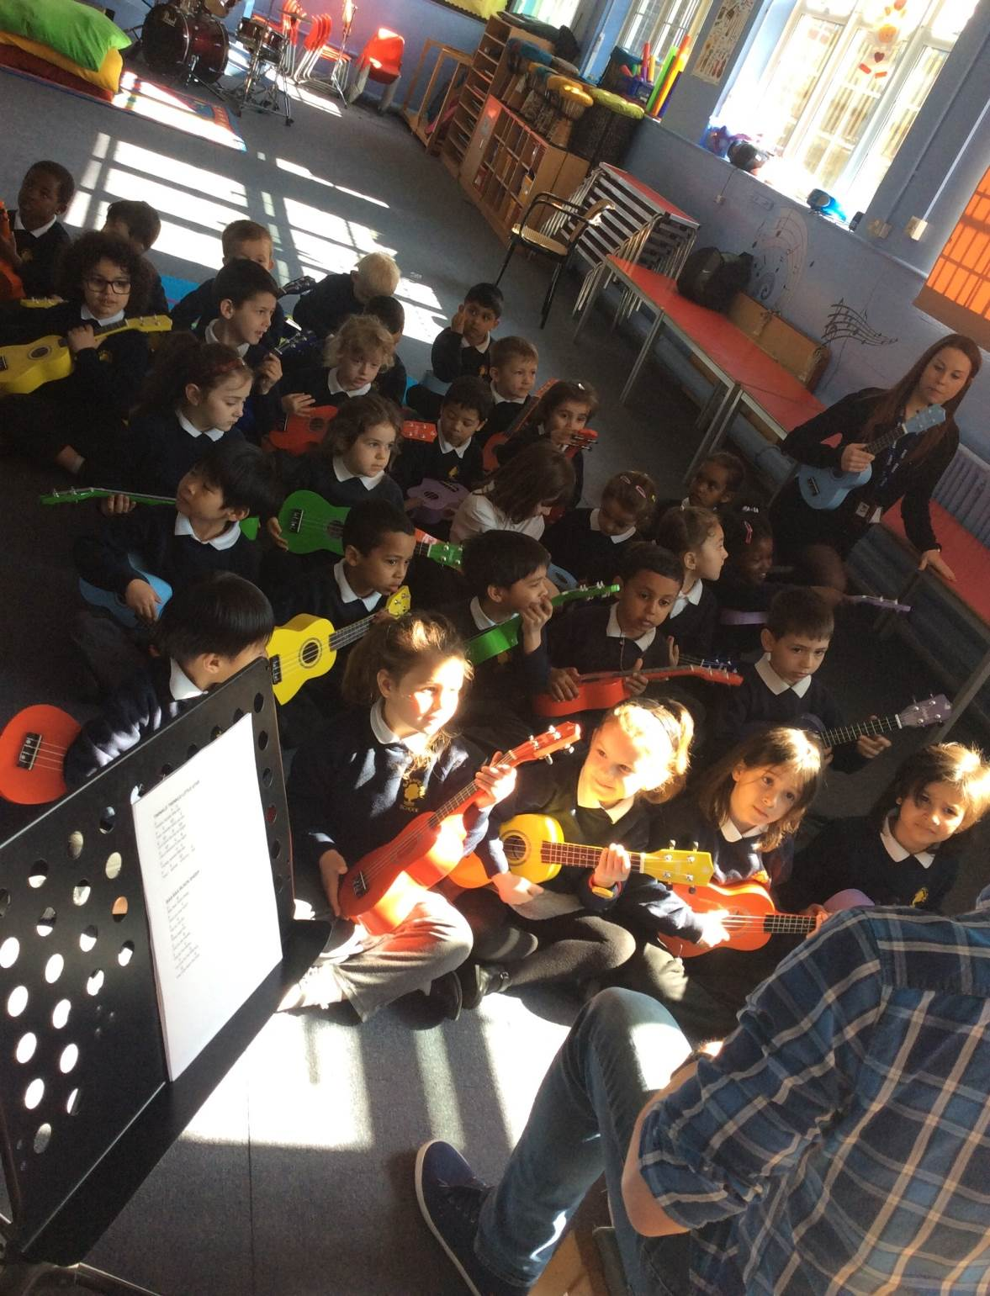
Supporting Inclusion
We have a number of systems in place to support children with their learning and socially so they can thrive under our guidance and care.

Slide 30
Using the internet to keep in touch!
School website is updated regularly with school information, class information, photographs etc
Parent App – search Apple app store or Google Play
Tapestry - Key form of communication

Slide 31
Reception Uniform
Boys
Long grey trousers (shorts in summer)
White polo t-shirt with logo
School jumper with logo
Grey/black socks and black shoes
Girls
Grey skirt / trousers (summer dress during summer term)
White polo t-shirt with logo
School jumper with logo
White socks/ black tights and black shoes

Slide 32
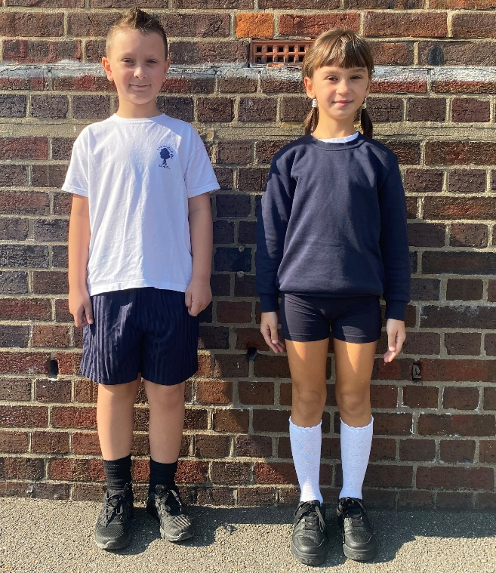
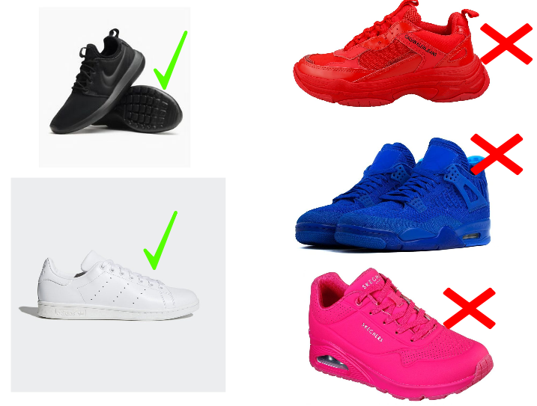
PE – all pupils
White pe top with school logo
Navy shorts
Navy / black plain jogging bottoms and sweatshirt can be worn for outdoor lessons during the colder months
Trainers

Slide 33
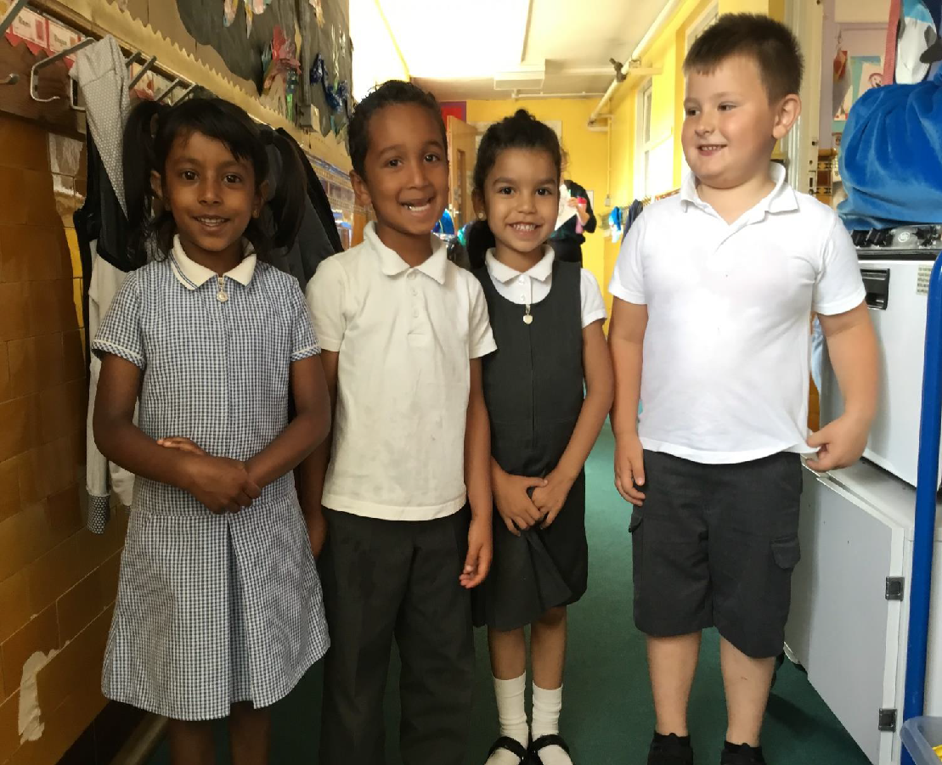
School Uniform
Please order unform via the school website. Collection days will be pre-arranged. Please do not leave this until September
Please note all uniform must be labelled with your child’s full name.
Children also need a book bag and water bottle

Slide 34
We will be staggering our intake, the provisional
start dates and times are as follows:
 | MILESTONE 1 9.05 am – 12.30pm | MILESTONE 2 9.05am – 3.10pm
Group 1 | Monday 5th September | Monday 12th September
Group 2 | Monday12th September | Monday 19th September
Group 3 | Wednesday 14th September | Wednesday 21st September

Slide 35
How can I help in partnership with the school ?
Children learn a great deal from their parents and teachers. Home and school are the two most powerful influences on your child and they should be seen to be always working together.
Take an interest in your child’s learning – talk and listen
Read every day to and with your child
Support the school in ways you can
Attend meetings when asked
Let us know if you have a concern or something significant changes at home

Slide 36
Meeting your New teacher
If your child is new to Barnfield school please come to visit us and meet your new teacher on Tuesday 5th July at 3.30pm in the playground or Friday 8th July at 3.30pm.
If your child is already in Barnfield Nursery we are supporting your child with transitions in school.

Slide 37
Thank you
We are really looking forward to getting to know you and your children and we hope you are excited too!

